Slide 1
The Ultimate Hands-On Hadoop: Tame your Big Data
15 March, 2024

Slide 2
Learn all the buzzwords and Install the Hortonworks Data Platform Sandbox

Slide 3
If you have trouble downloading Hortonworks Data Platform...
In the next lecture, we're going to install a complete "big data" framework - Hortonworks Data Platform - on your own desktop!
However, the download process on the Cloudera website seems to work unreliably at times. If you find you cannot download the HDP 2.6.5 sandbox image for Virtualbox as shown, try this direct link to their HDP 2.6.5 download:
https://archive.cloudera.com/hwx-sandbox/hdp/hdp-2.6.5/HDP_2.6.5_virtualbox_180626.ova
Or, if you need 2.5 instead:
https://archive.cloudera.com/hwx-sandbox/hdp/hdp-2.5.0/HDP_2.5_virtualbox.ova
Remember, you need at least 8GB of free RAM on your system to run HDP. If you don't have that much memory, don't worry - you can still learn by just watching the videos.
Onward!

Slide 4
Warning for Apple M1 users
If you are using one of the new M1 chip based Apple computers, be aware that VirtualBox is not compatible with this platform. You need VirtualBox in order to run the HDP Sandbox used in the hands-on activities in this course.
As far as we can tell, Oracle has no plans to port VirtualBox to the M1 platform; it requires an x86 chip. Fundamentally, HDP requires an x86 chip to run on - virtualization can't emulate an entirely different chip.
If the only system you have access to is an M1 based system, we recommend just watching the videos of the hands-on activities instead of attempting to follow along yourself.

Slide 5
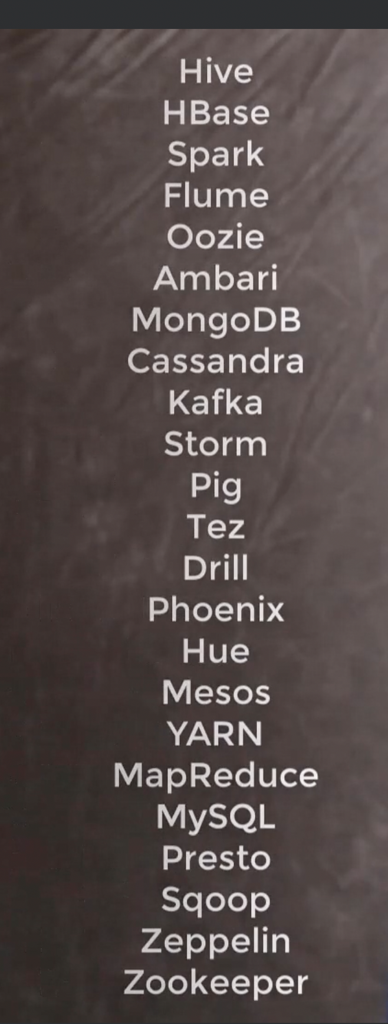
25 technologies related to Hadoop

Slide 6
Install VirtualBox 7.0.8 for Mac (M1/M2 chips)
Hortonworks Data Platforms – download ova image from cloudera
Fpr downloading data
https://grouplens.org/
Username: maria_dev
Password: maria_dev

Slide 7
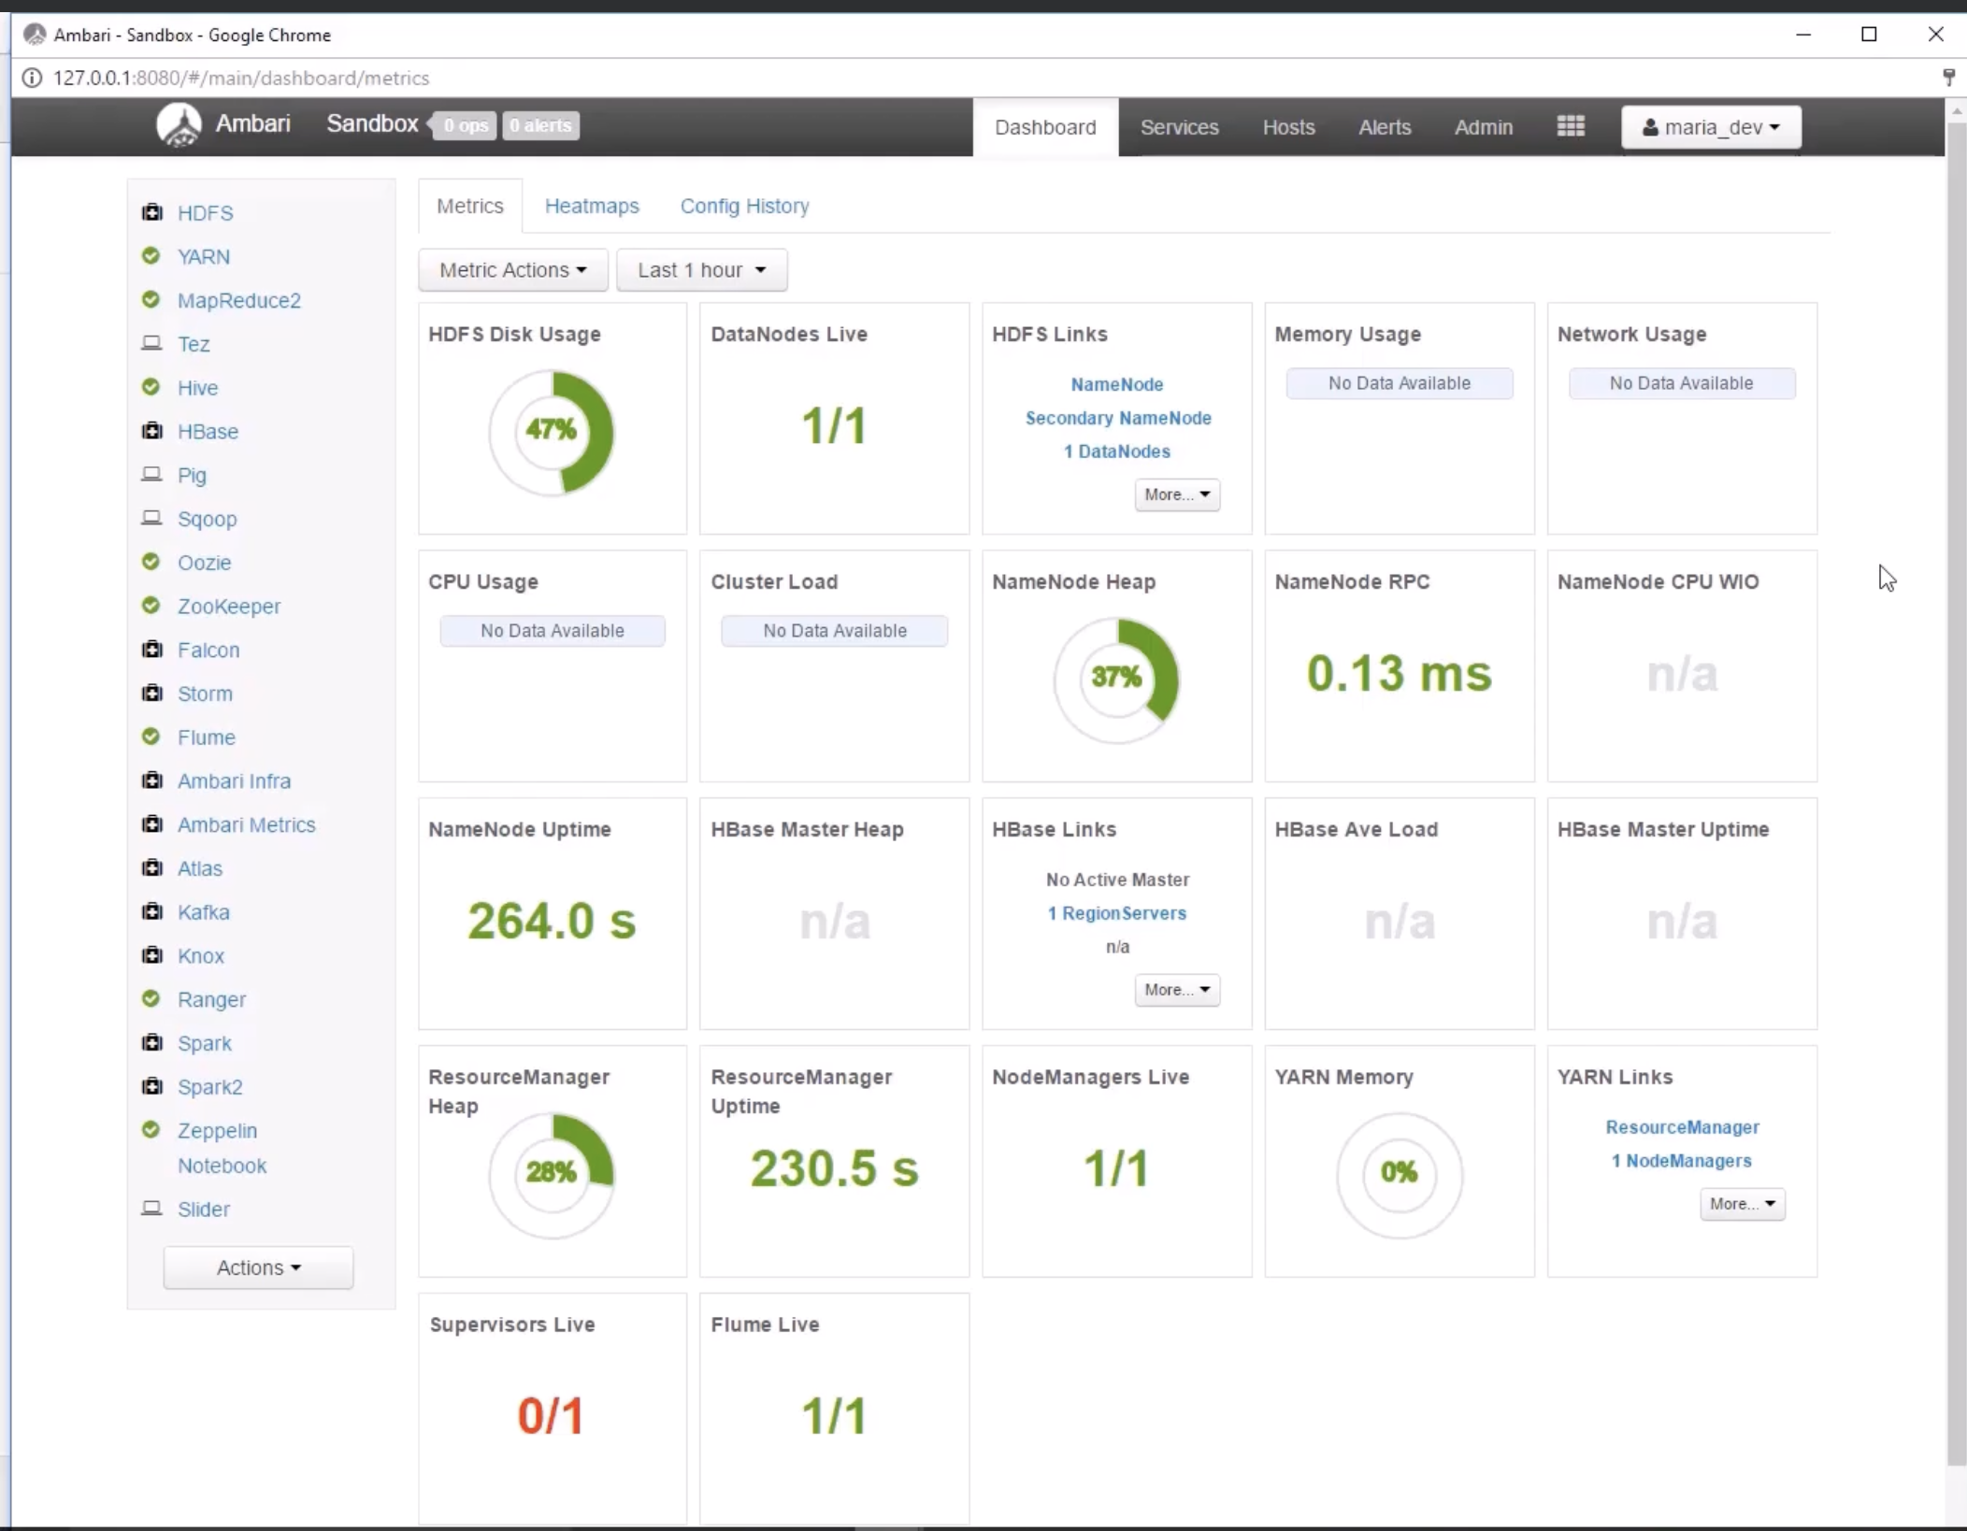

Slide 8
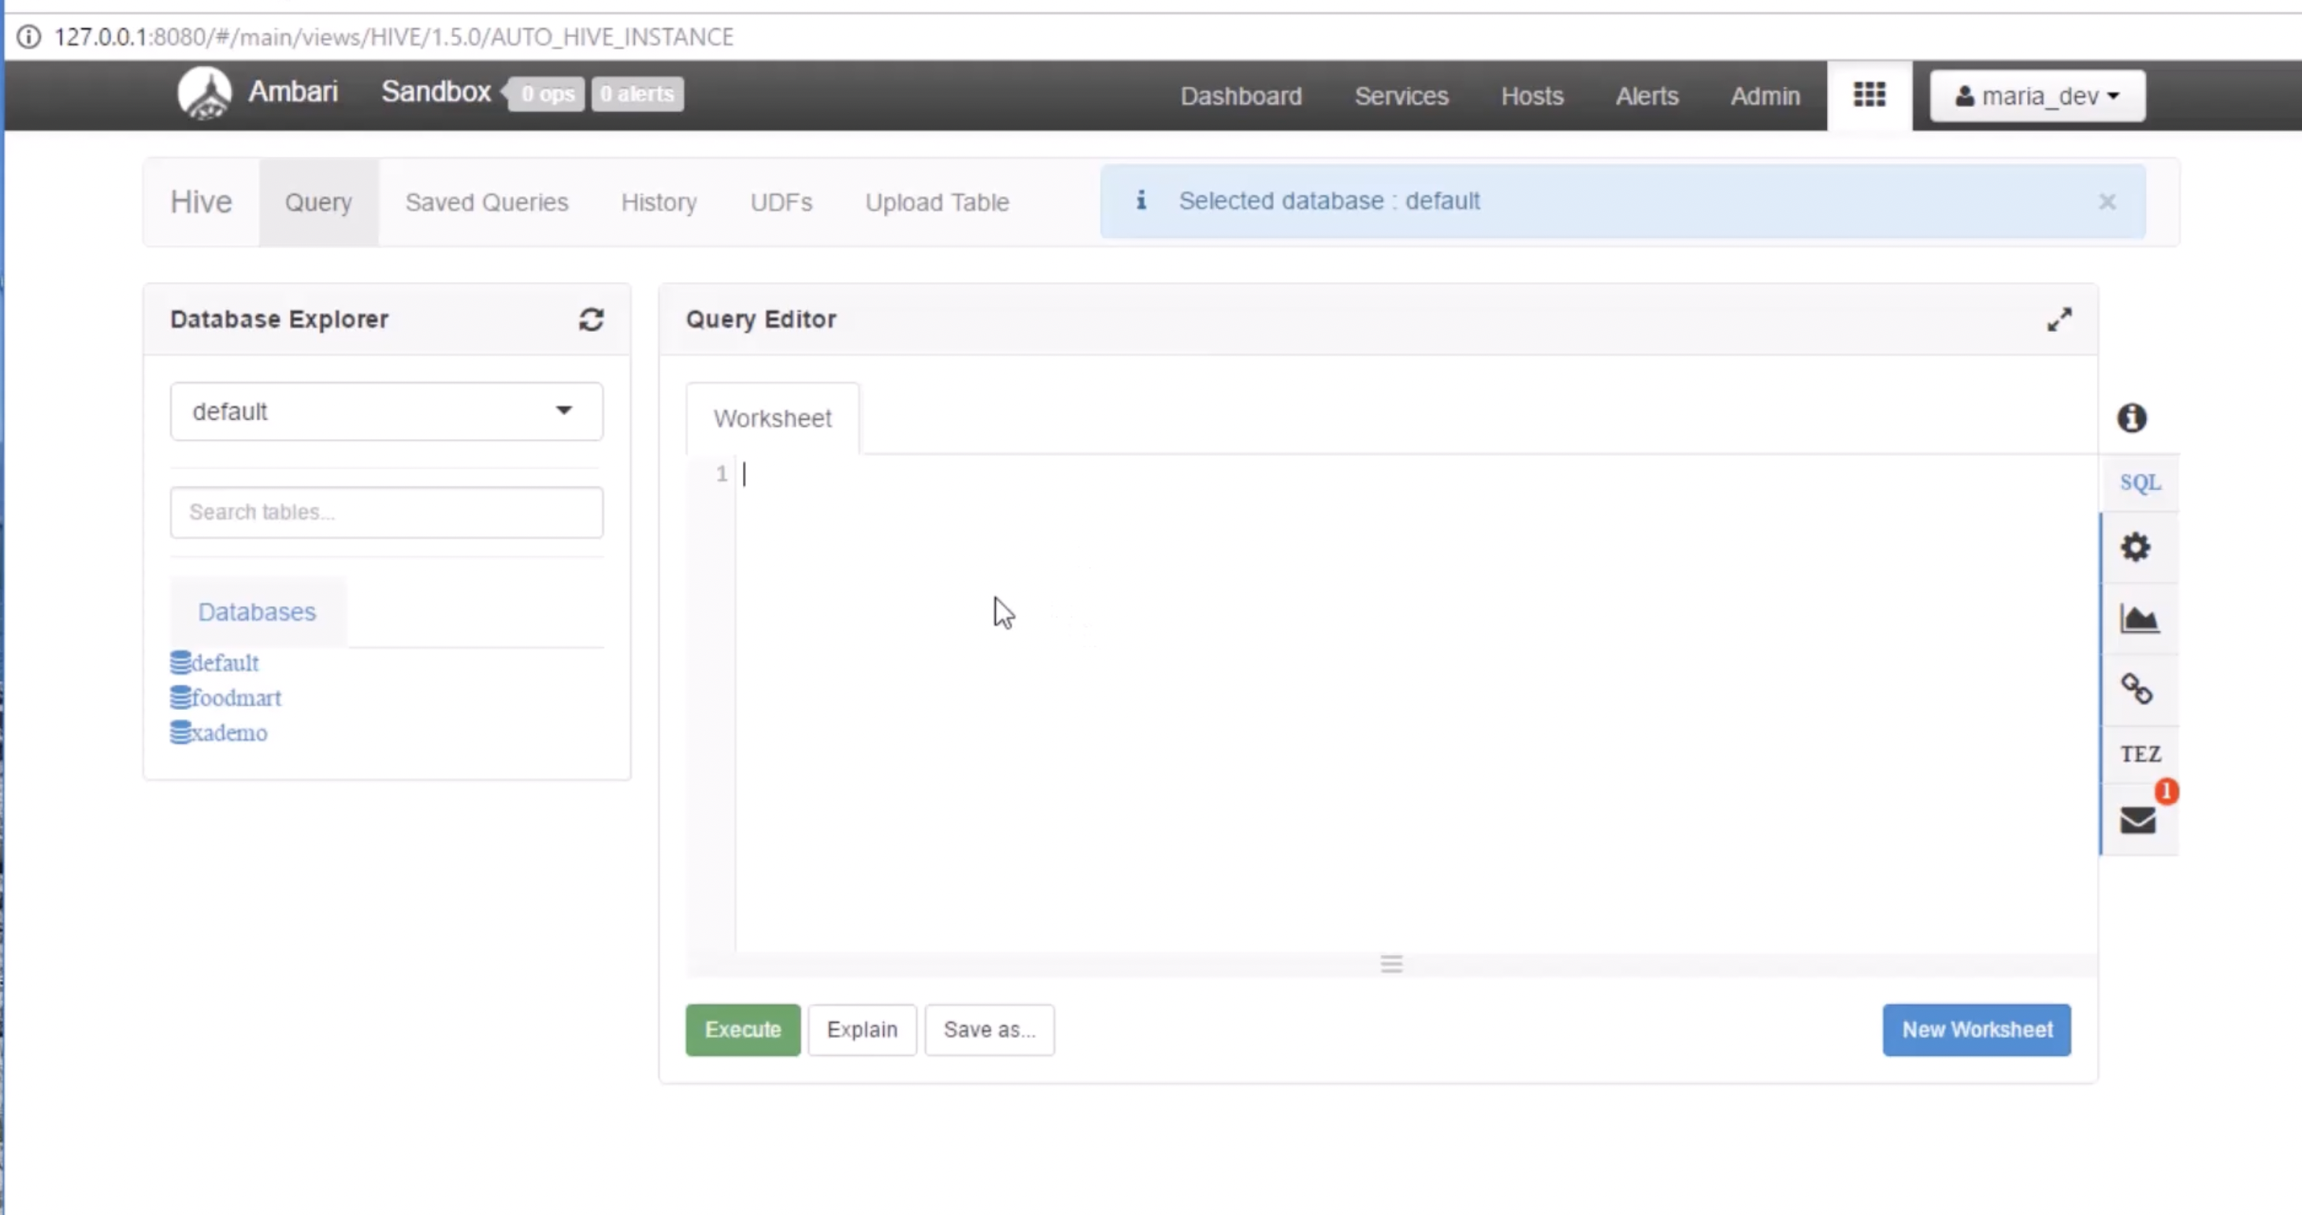
Hive view

Slide 9
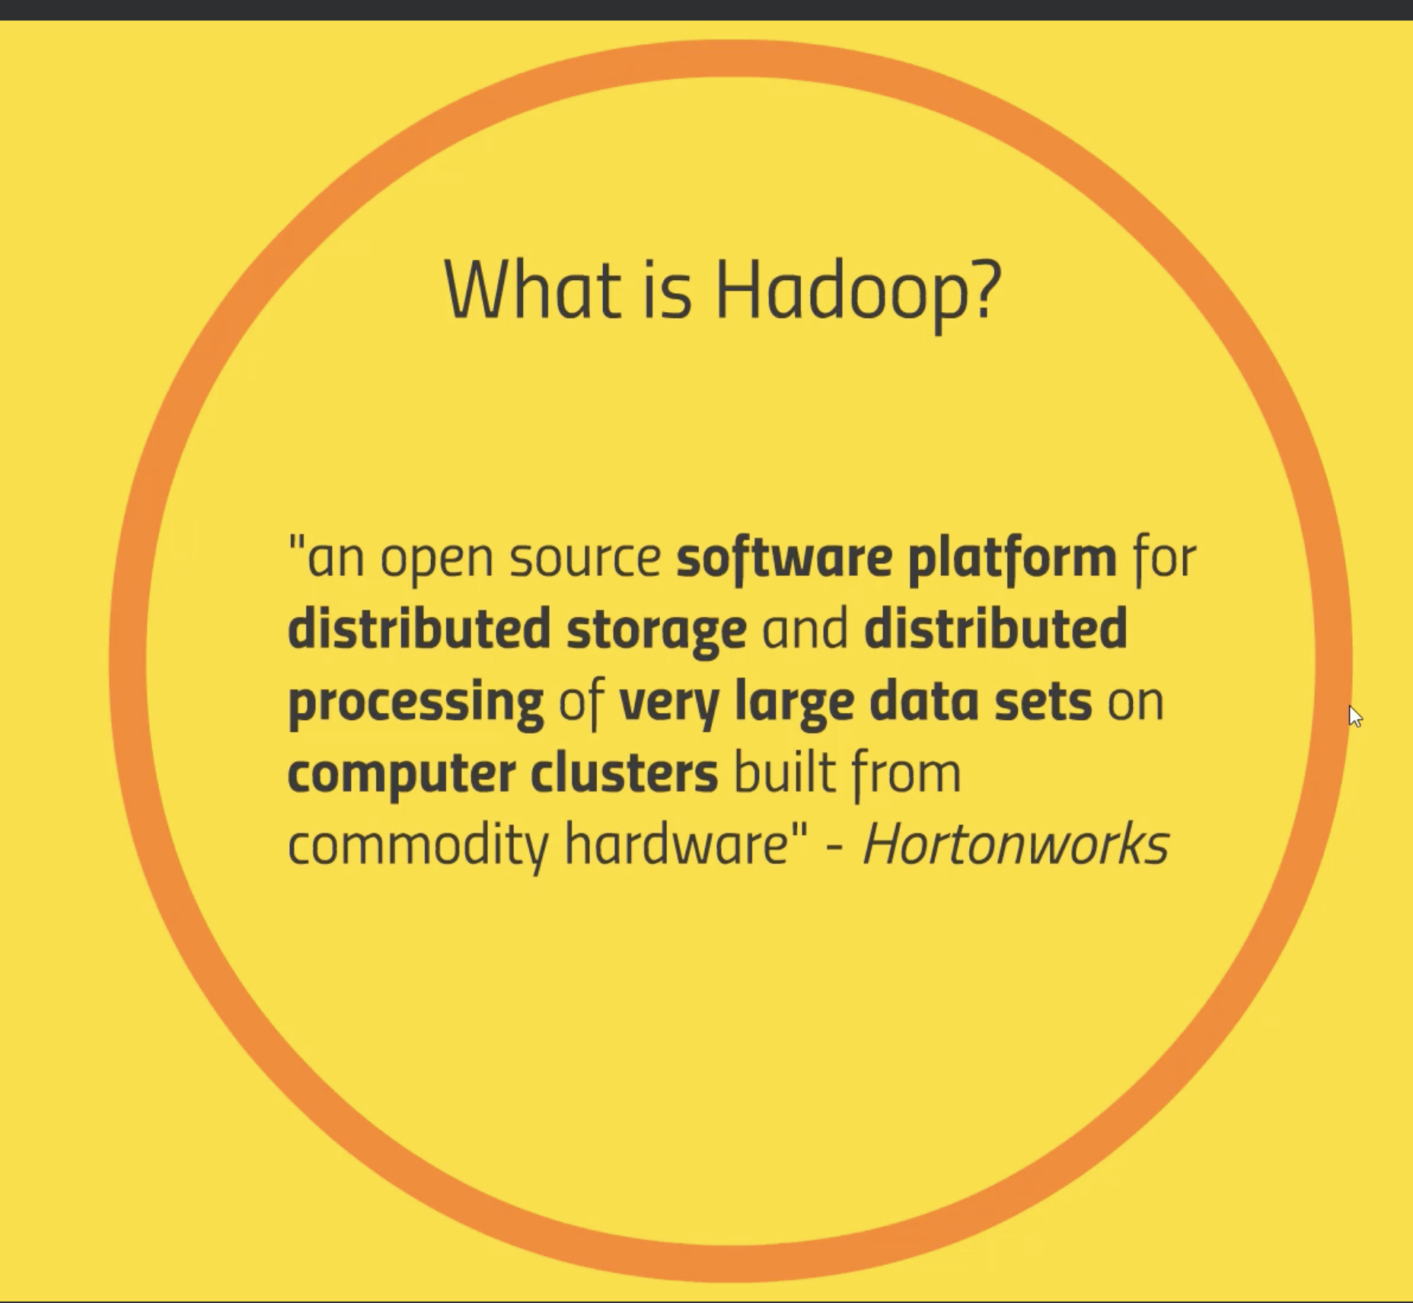

Hadoop overview and History

Slide 10
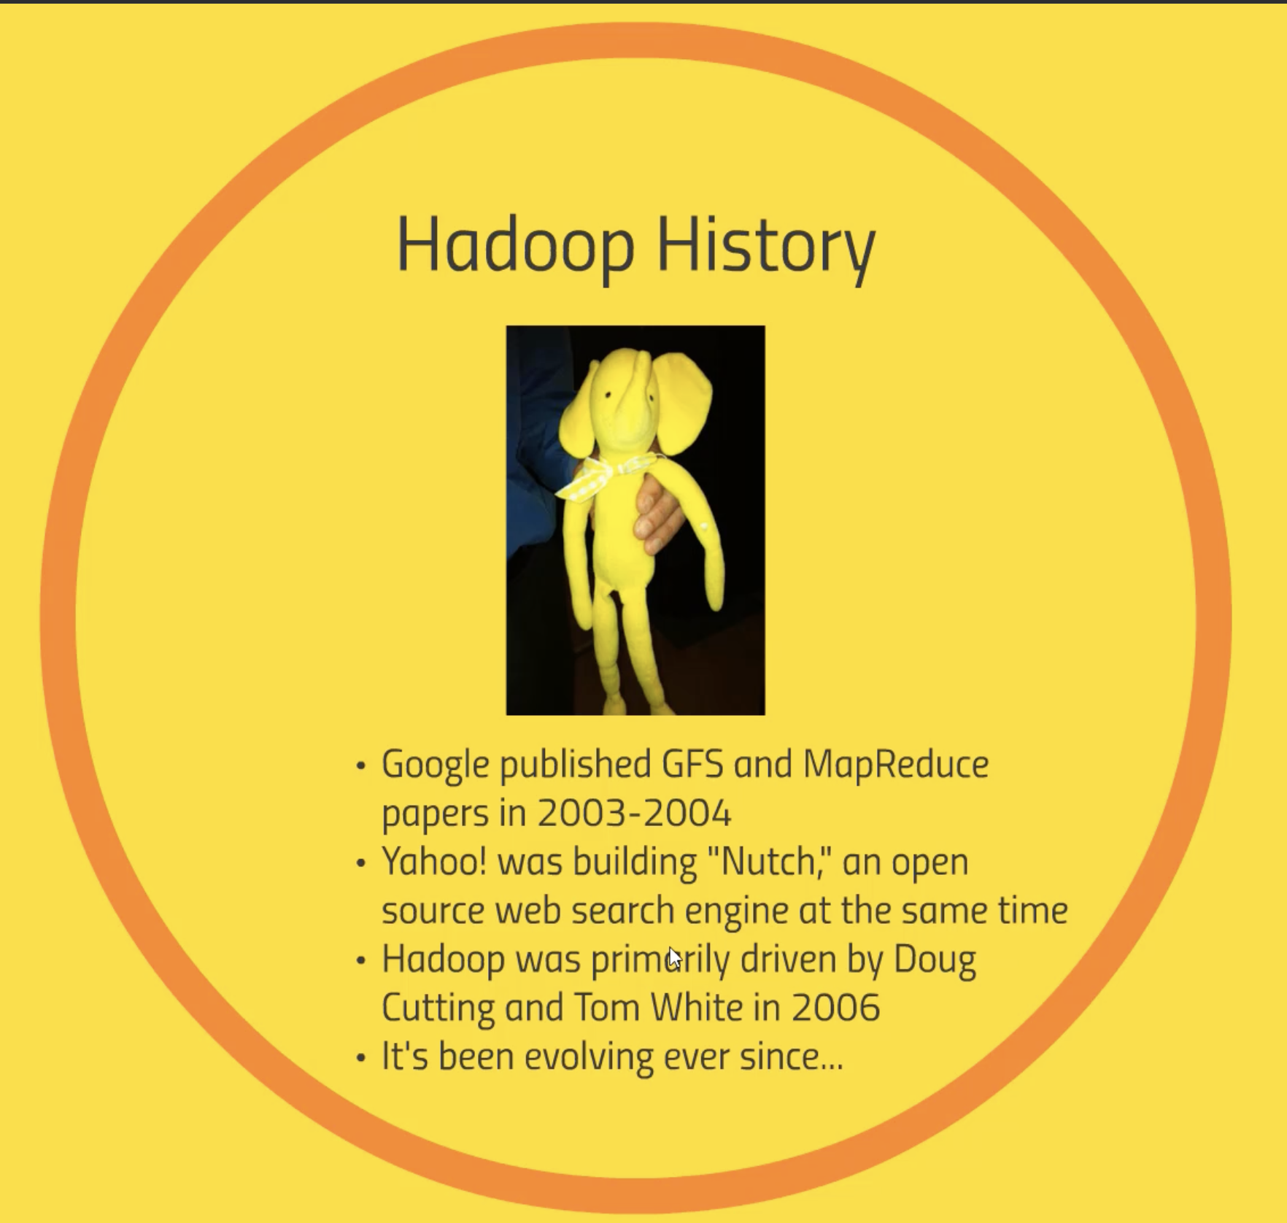
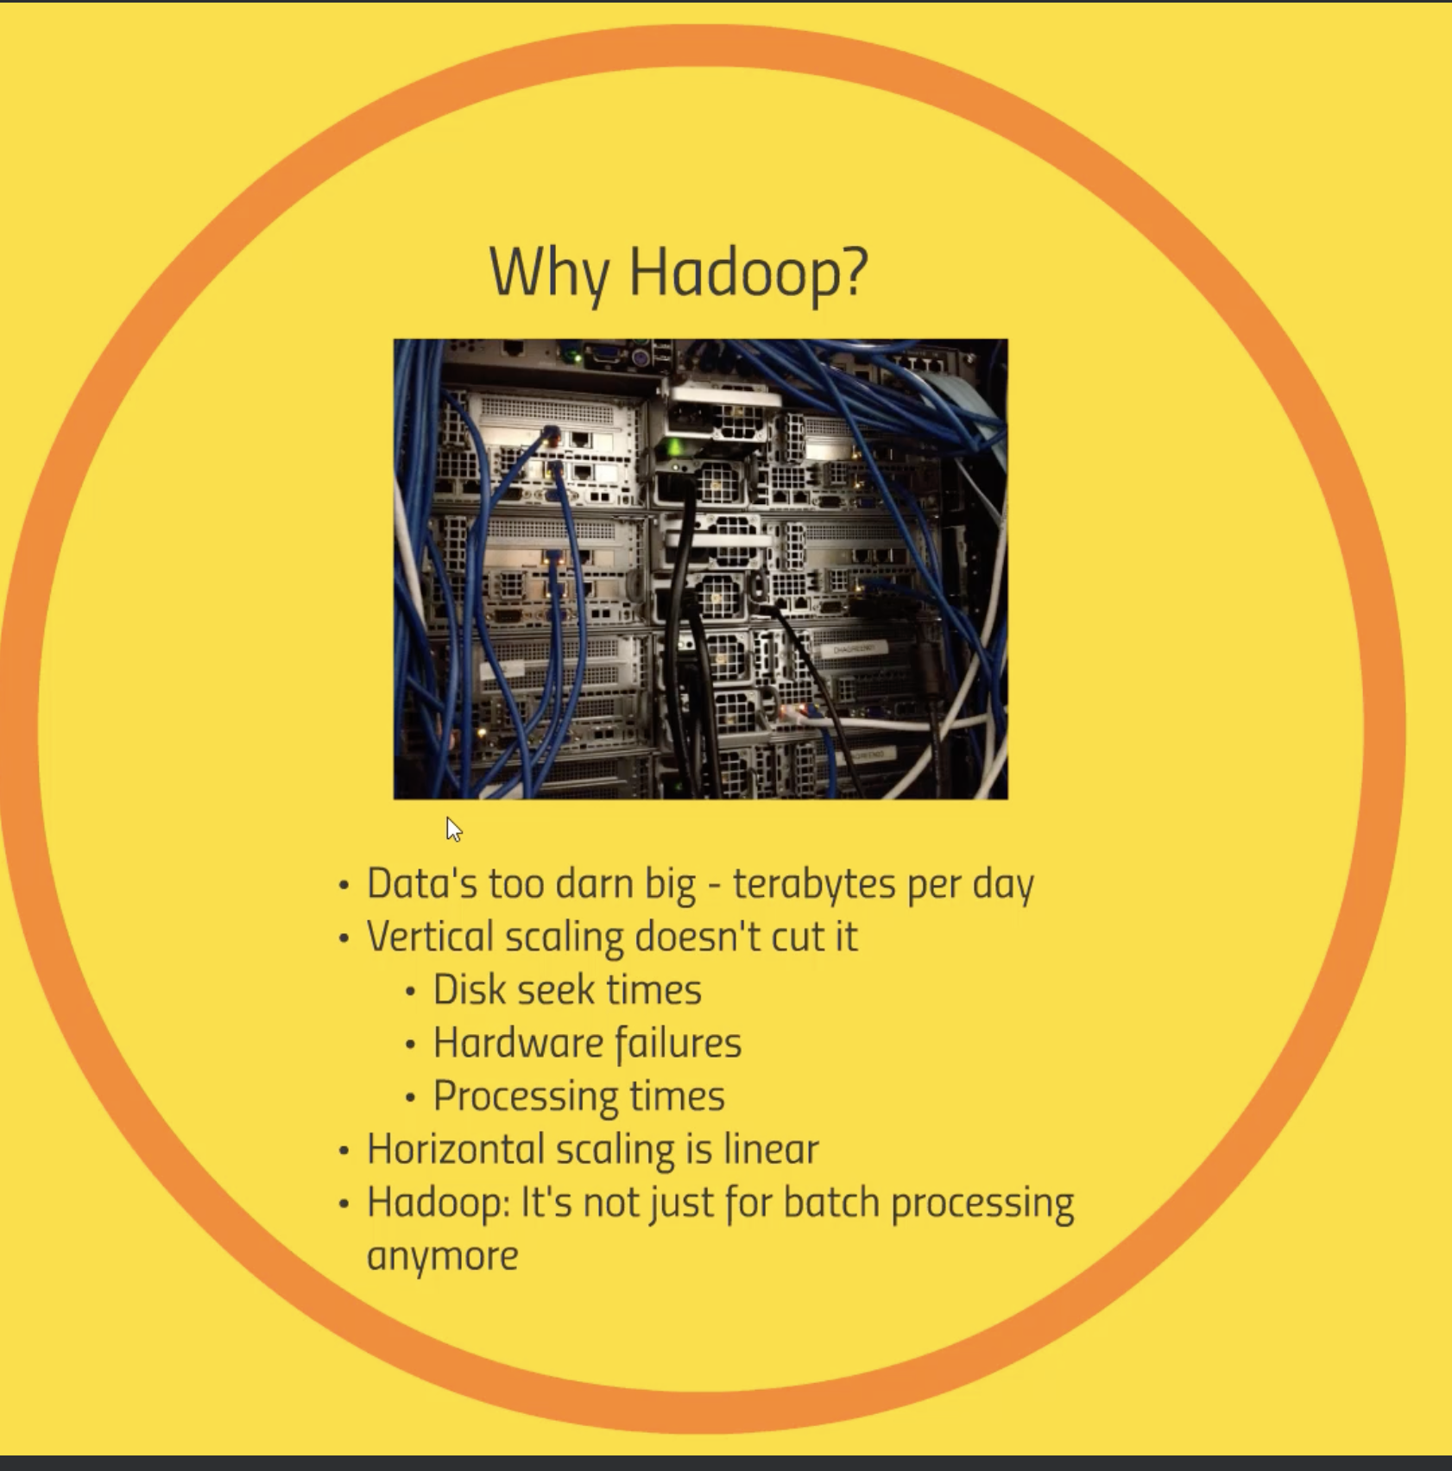

Slide 11
Overview of Hadoop Ecosystem
Hadoop distributed file system (HDFS)
YARN (yet another resource negotiator) – used for data processing
MapReduce - programming interface, have mappers and reducers
Mappers have ability to transform data in parallel across cluster in efficient manner
Reducer aggregate that data
Java/python MapReduce code
PIG – High level scripting language, SQL style syntax
HIVE- make it look like SQL, run SQL queries

Slide 12
Apache Ambari – gives you overall view of cluster
Mesos – alternative to YARN
Spark – can run queries on top of data, sits on top of YARN/Mesos and same level as MapReduce
Need to write code in Python/Java or Scala
It can do Machine learning, Stream data, run SQL queries
TEZ- similar to Spark, uses Directed Acyclic graph, can be used using HIVE

Slide 13
Apache HBASE- NoSQL Database, Columnar database, faster, OLTP
Apache Storm – made for processing streaming data
OOZIE- way of scheduling jobs on clusters
Zookeeper – used for coordinating everything, reliable and consistent performance across cluster, check who the current master node is etc.
Data Ingestion – Sqoop – connector b/w Hadoop and SQL DBs, Flume - transporting weblogs, Kafka – collect data from web servers and pass to Hadoop

Slide 14
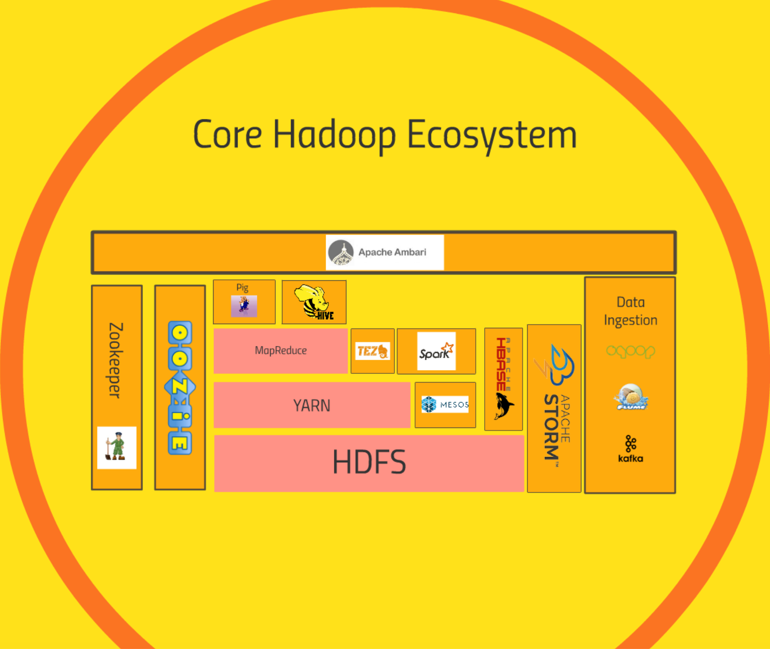

Slide 15
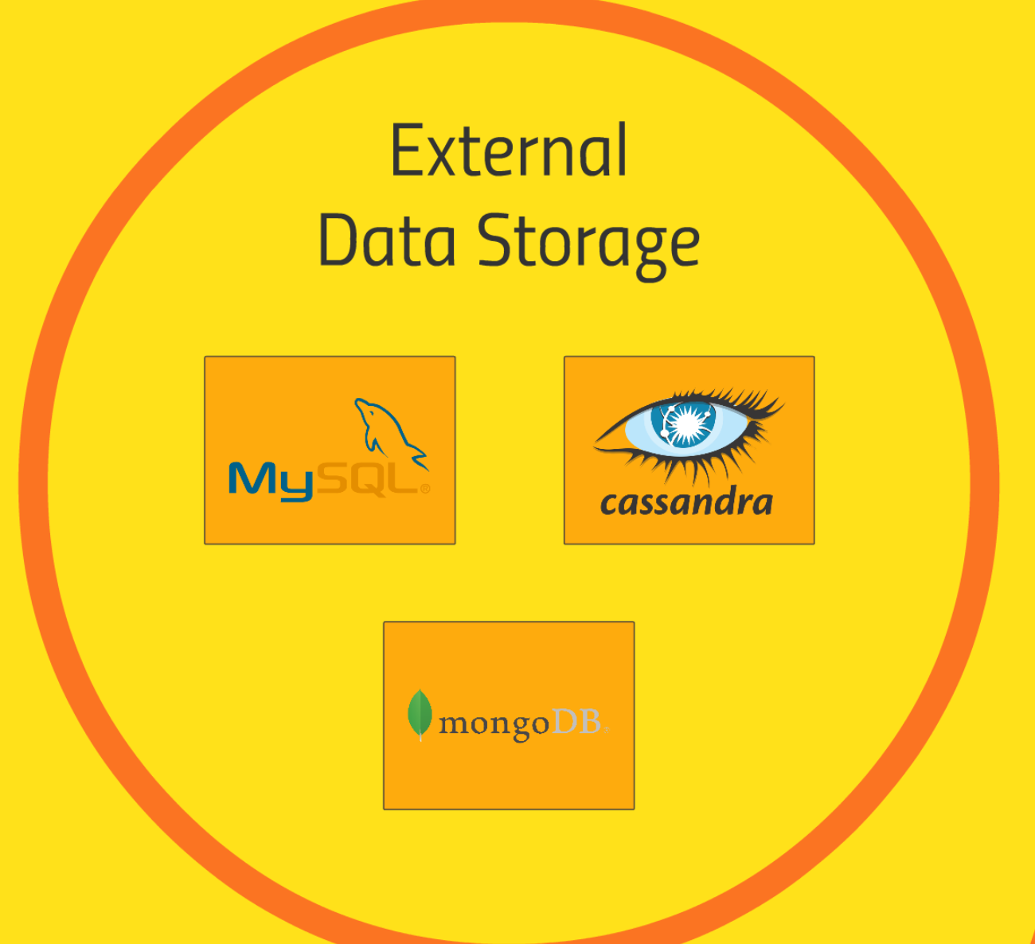
External Data Storage
MySQL
Cassandra – columnar data store
MongoDB – document db

Slide 16
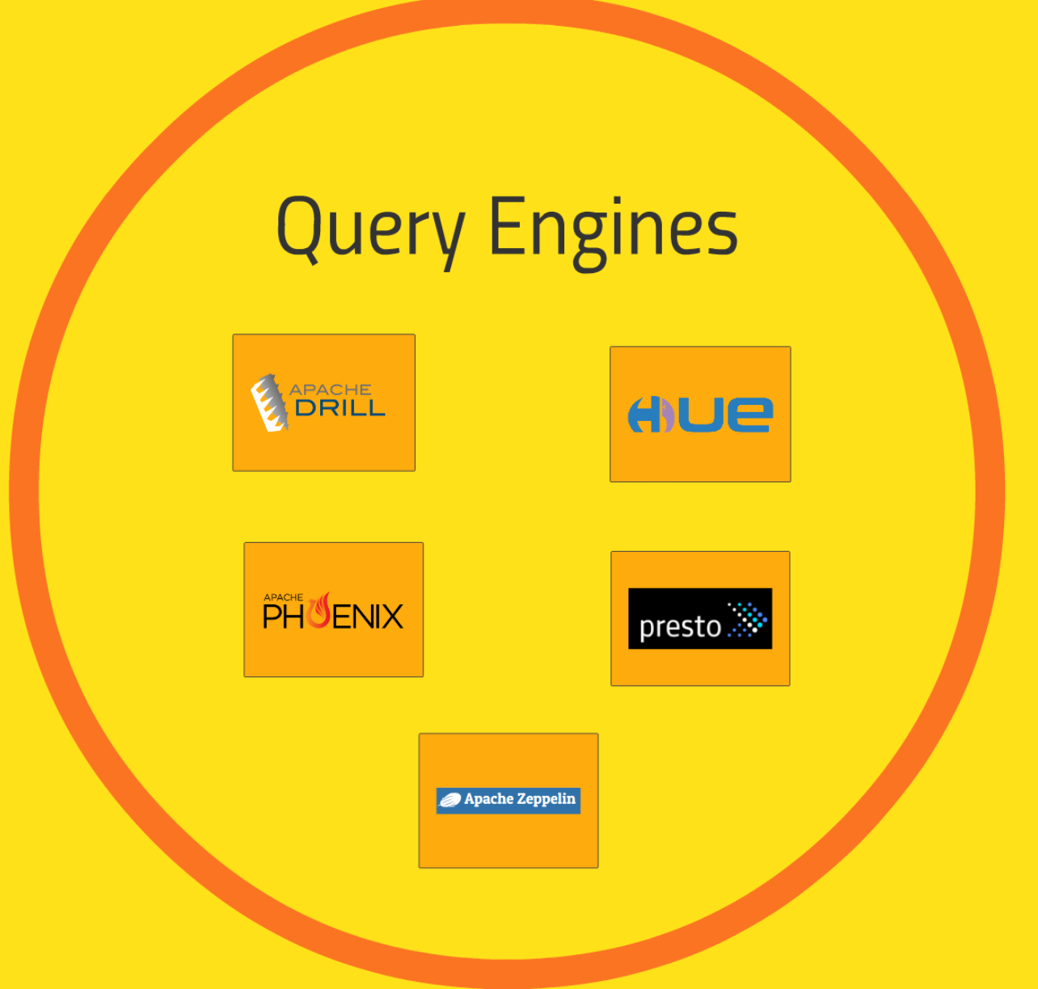
Query Engines
Apache Drill – write SQL queries for NoSQL DBs
Hue – used with HIVE, Hbase. For Cloudera, takes role of Ambara
Apache Phoenix – similar to Drill, + OLTP, make NoSQL Data Store to relational data store
Presto – execute queries across cluster
Apache Zeppelin – notebook type of approach to UI

Slide 17
Using Hadoop’s Core: HDFS and MapReduce

Slide 18
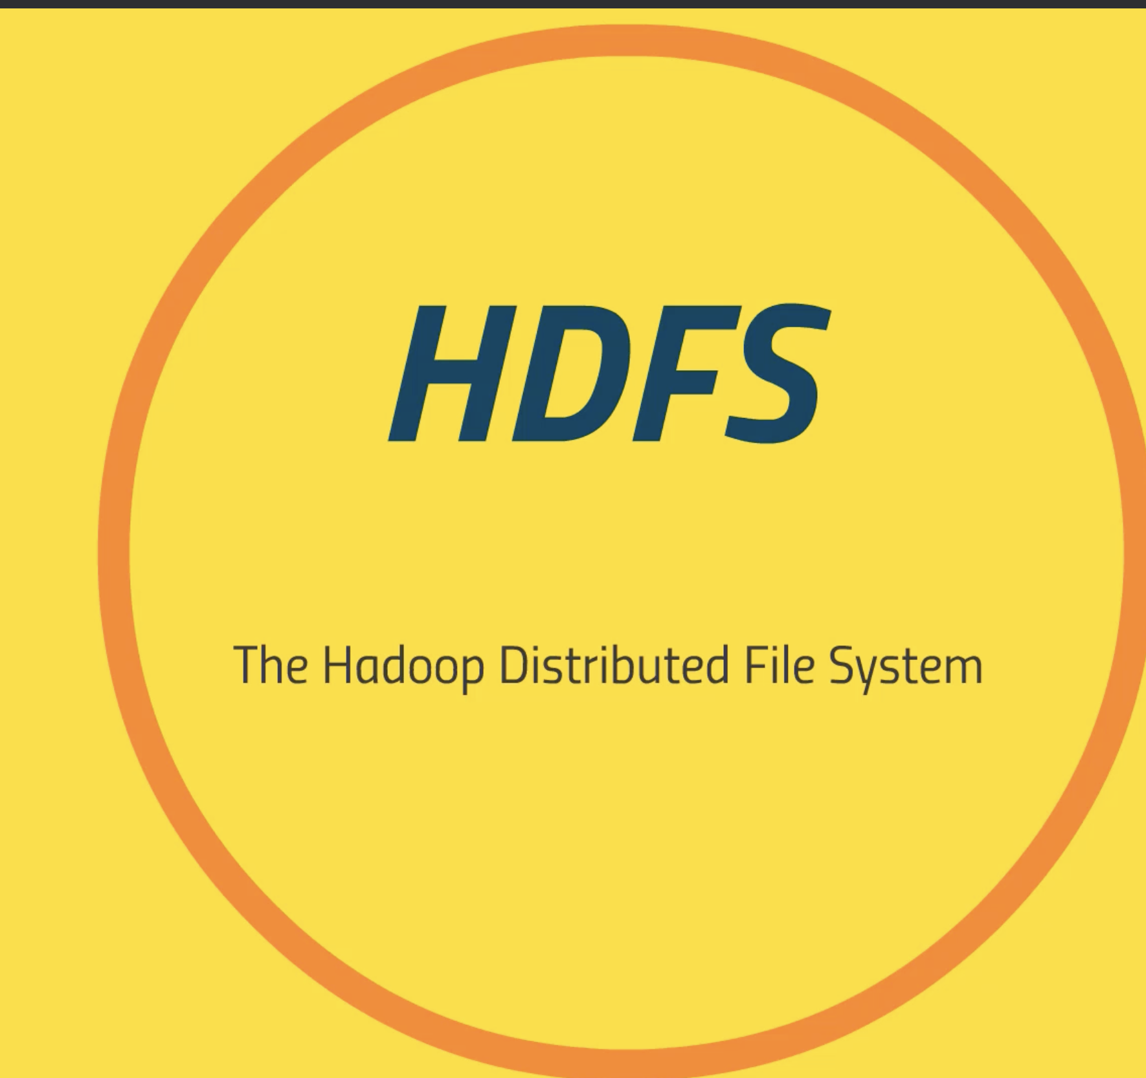
HDFS: What is it, and how it works
Overview
Handles large files
By breaking them into blocks
128MB by default
Stored across several commodity computers

Slide 19
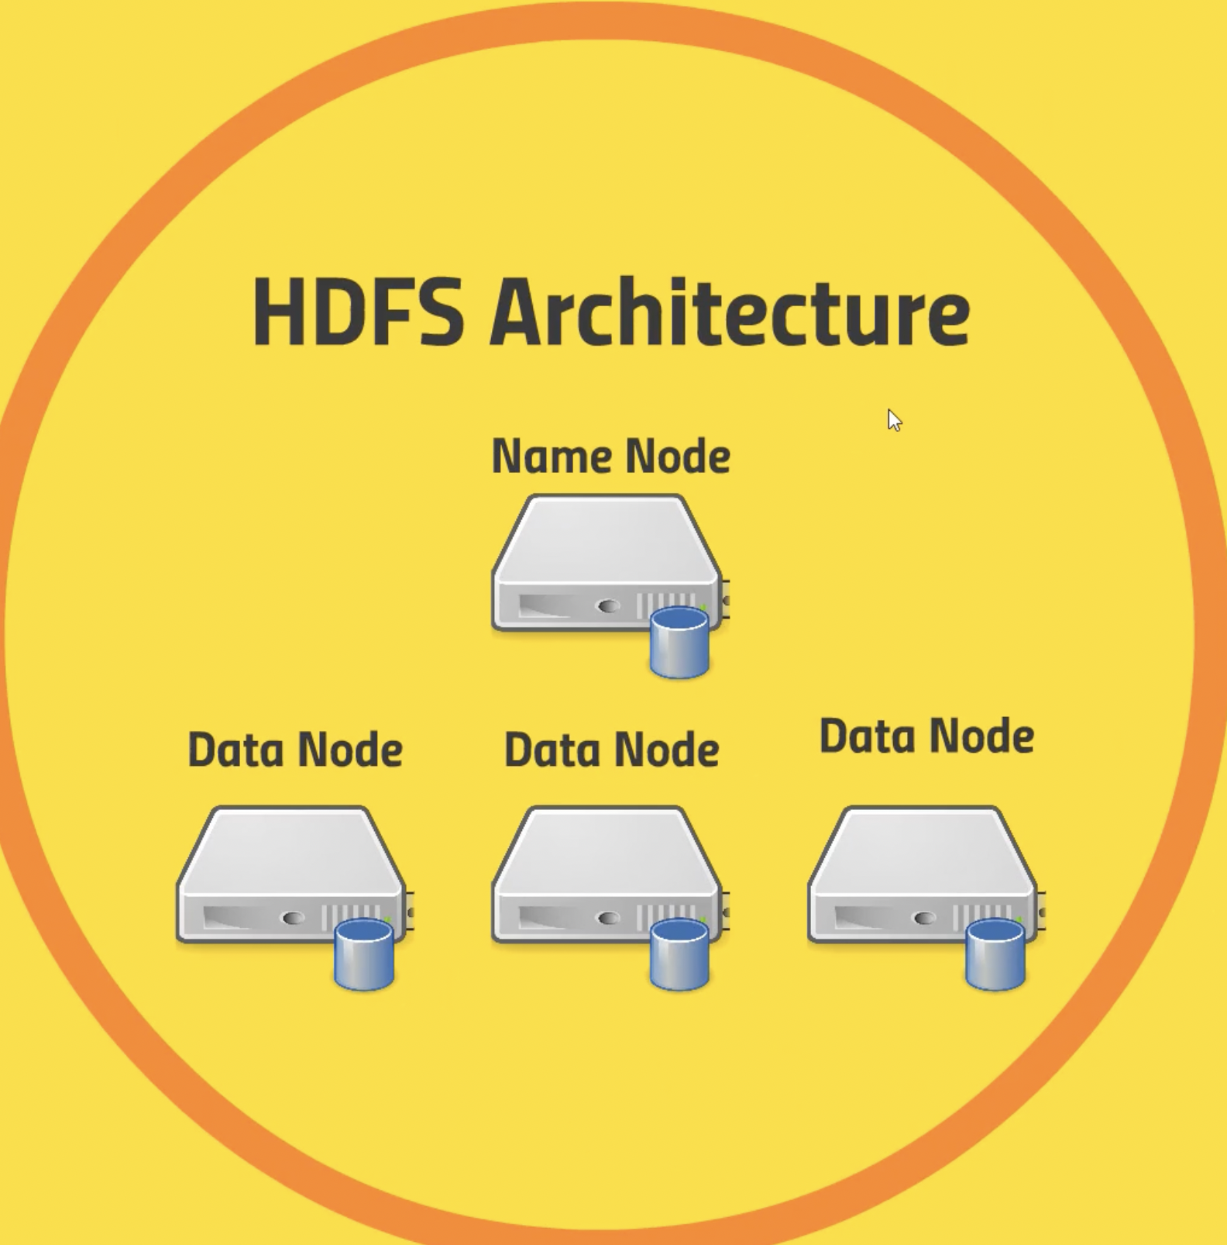
Name node: where all blocks exists
Name log, edit log
Keeps tracks of what is where on Data nodes
Data node: client application talks to, actually stores blocks of files

Slide 20
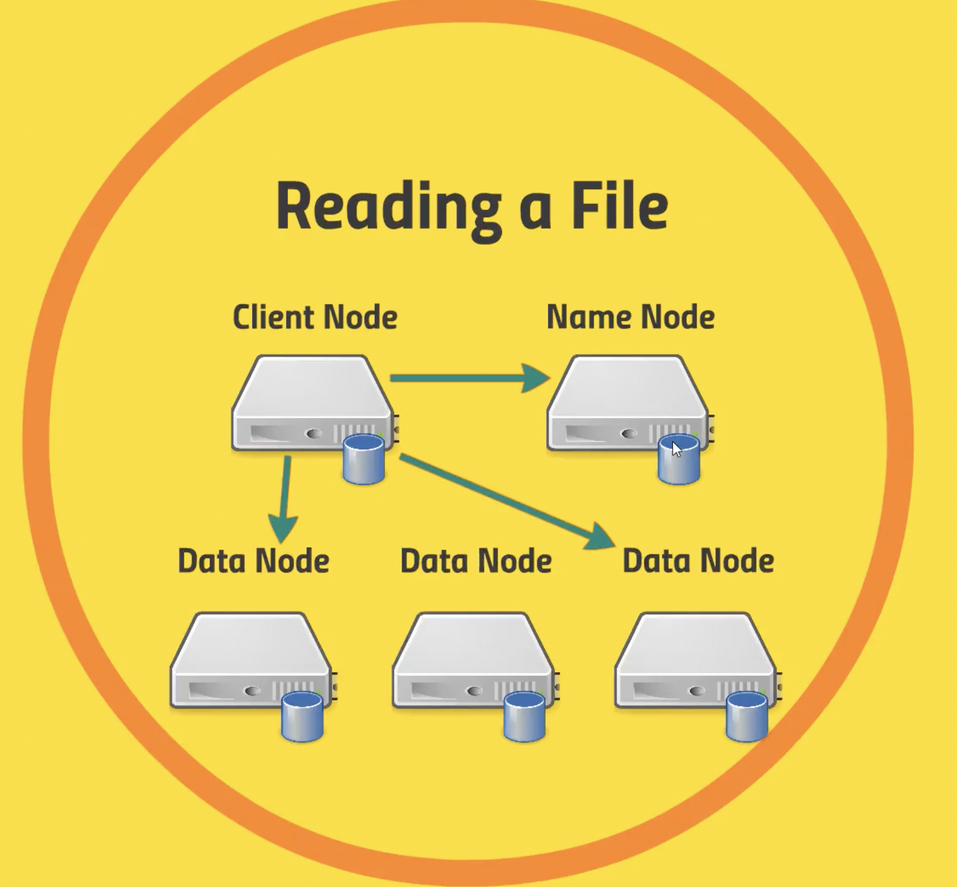
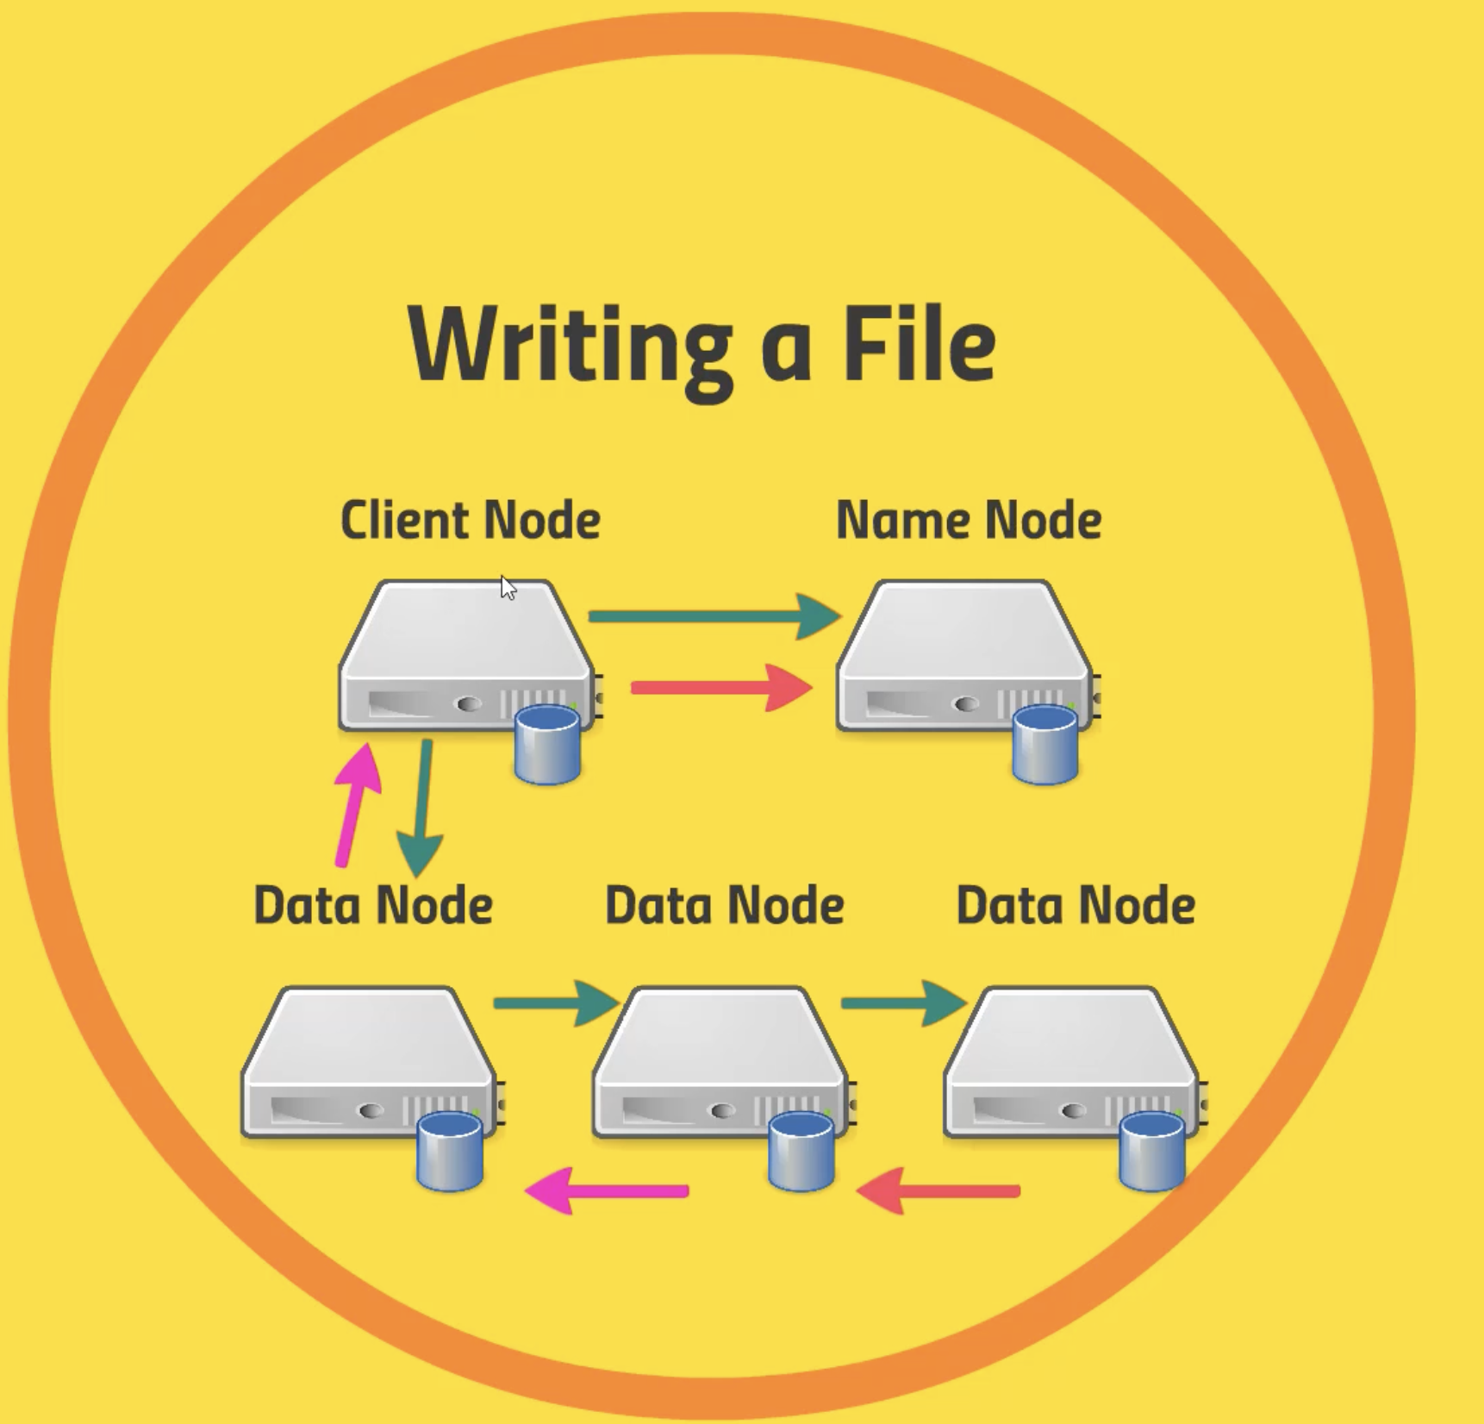

Slide 21
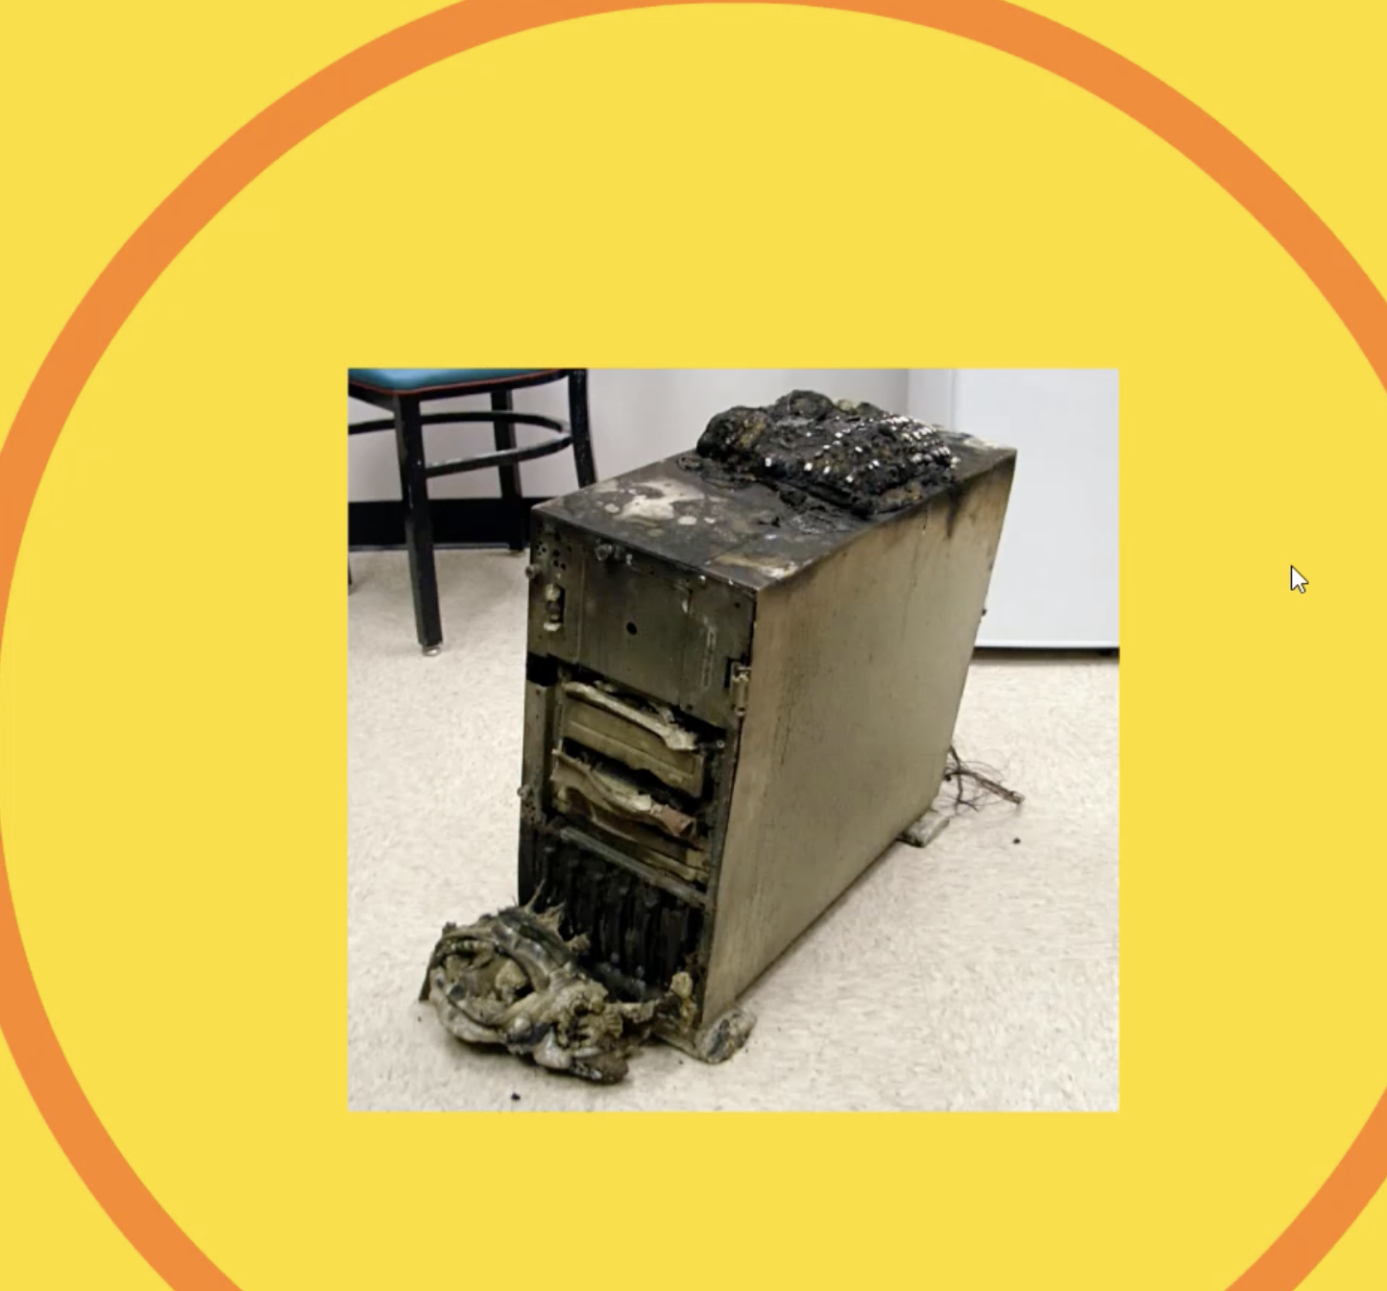
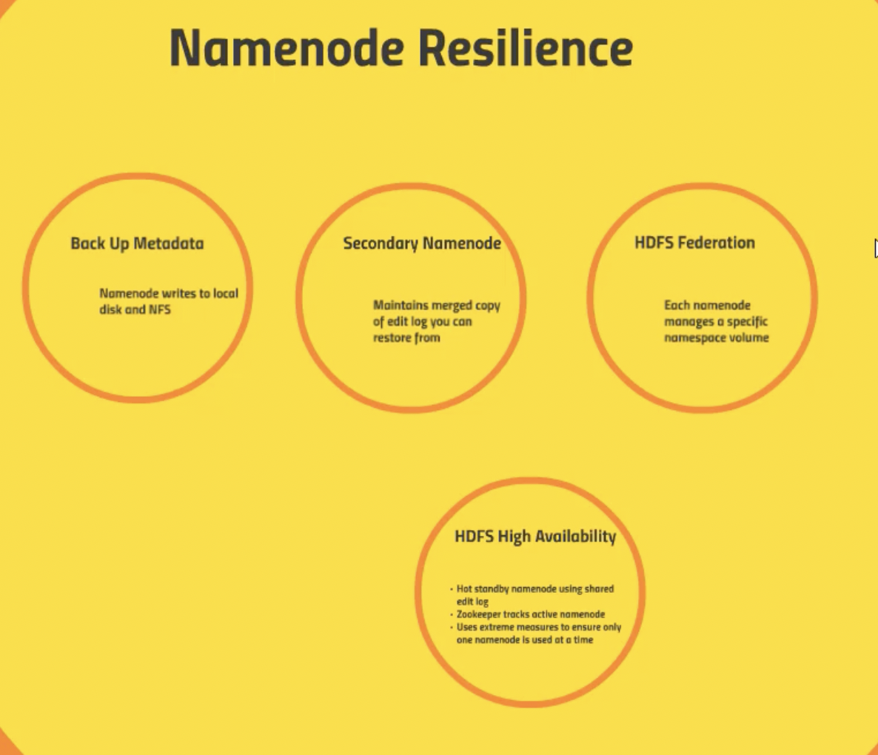

Slide 22
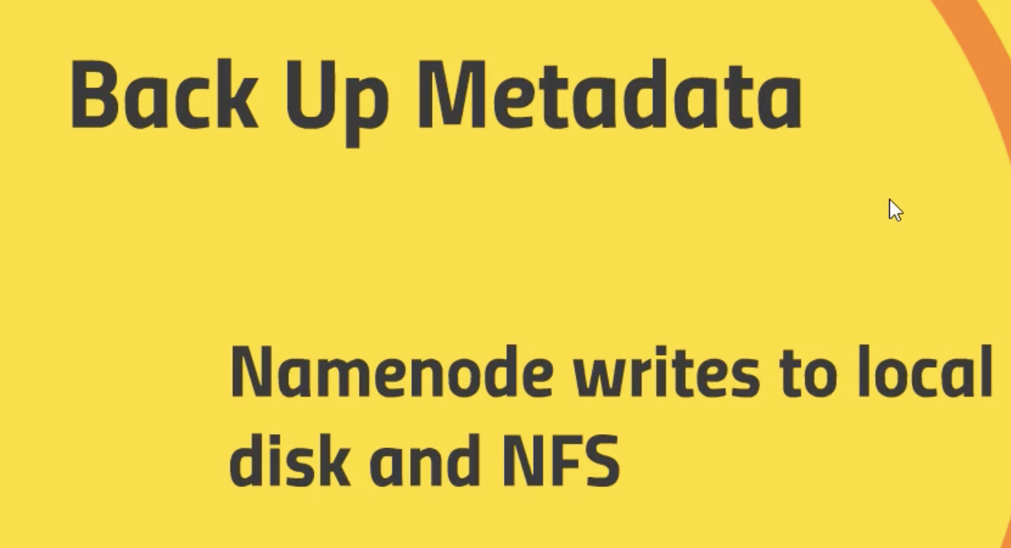
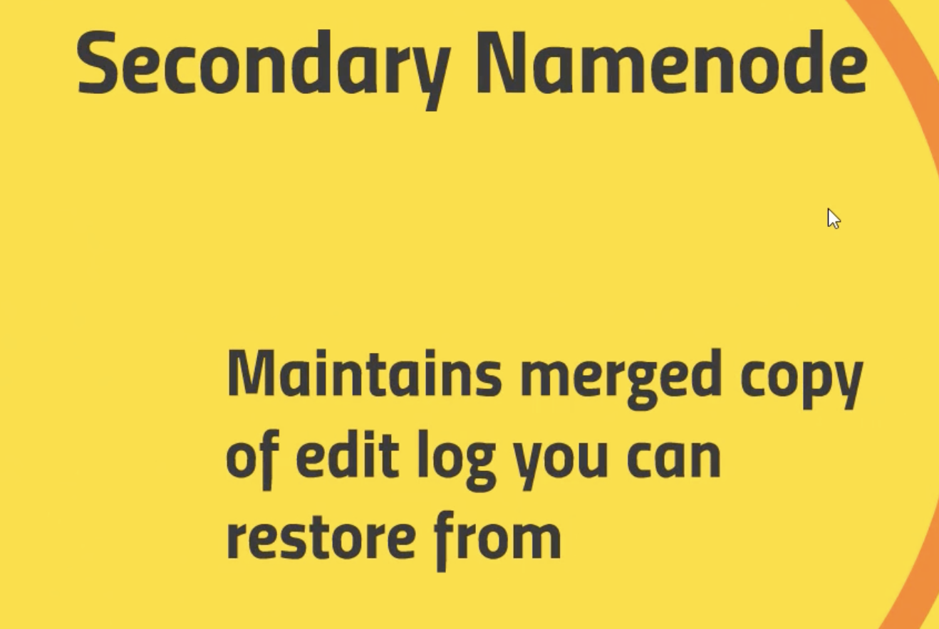
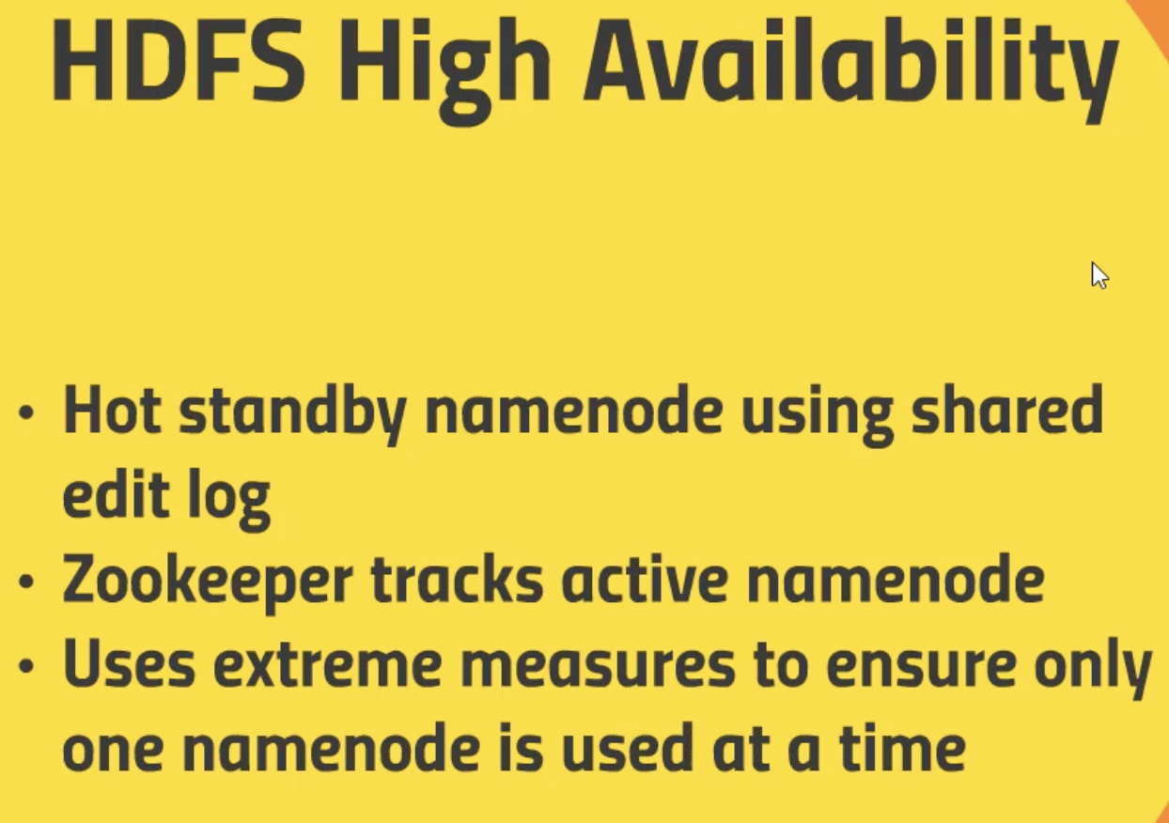
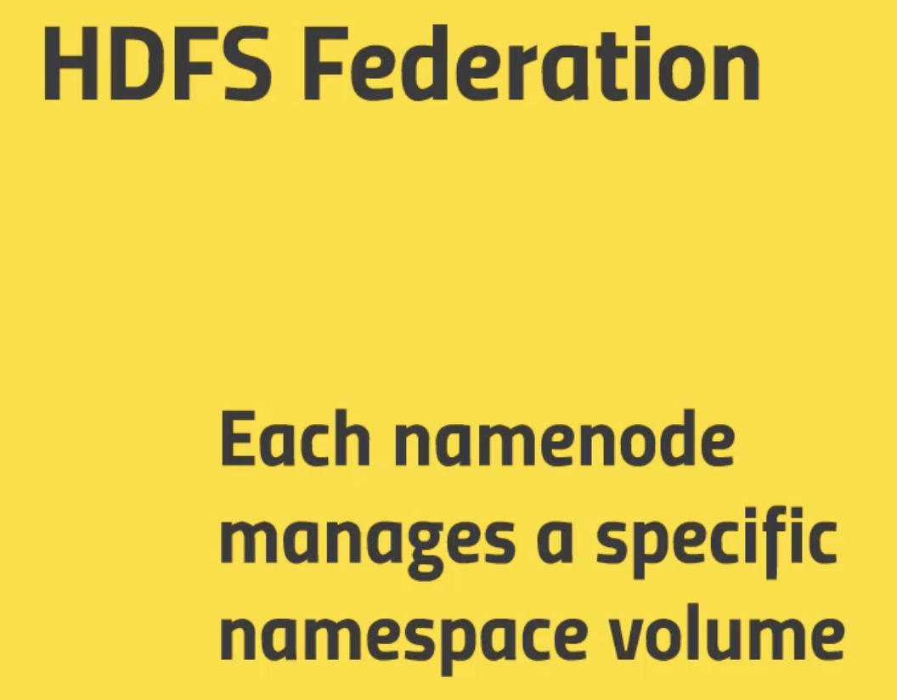

Slide 23
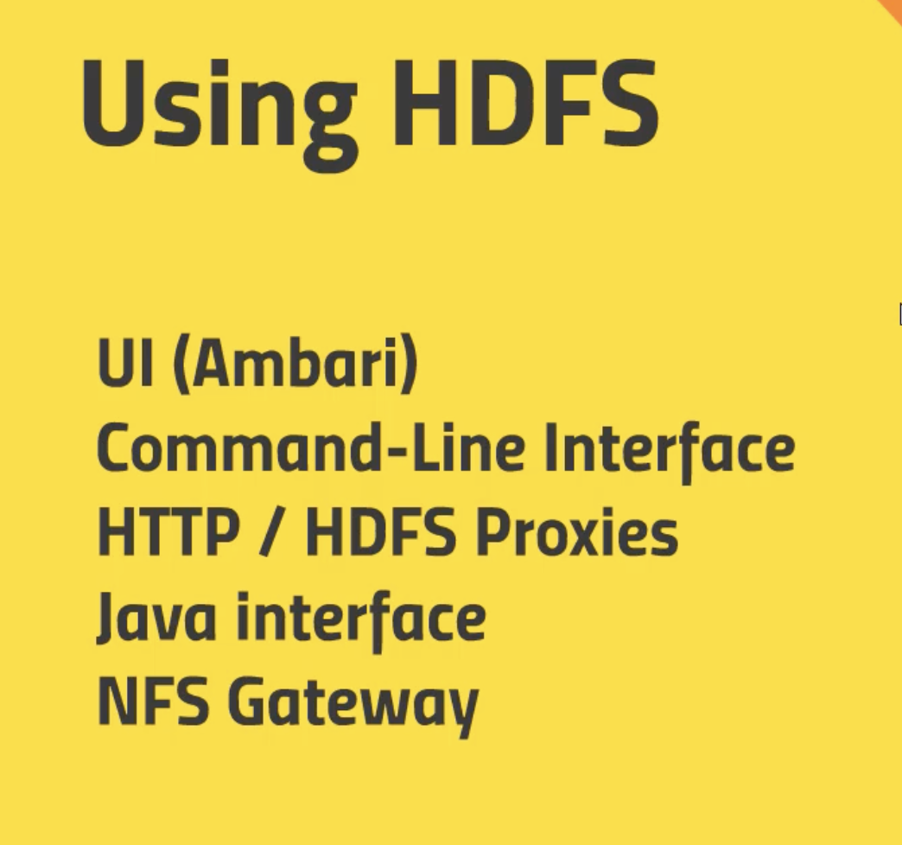
Alternate MovieLens download location
If you have trouble downloading the ml-100k data set
from grouplens.org, use this download location instead:
http://media.sundog-soft.com/es/ml-100k.zip

Slide 24
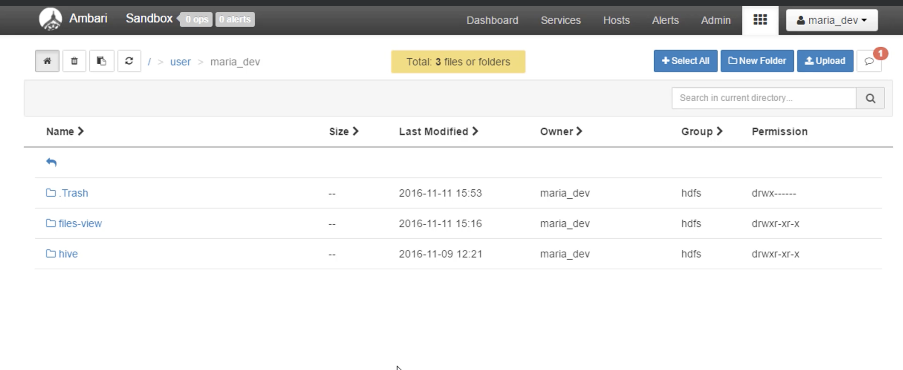
Installing the MovieLens dataset
File View -> /Users/maria_dev/ml-100k/ratings.data-

Slide 25
Install MovieLens Dataset into HDFS using command line
Ssh maria_dev@127.0.0.1 –p 2222
Hadoop fs –ls
Hadoop fs –mkdir ml-100k
Wget http://media.sundog-soft.com/hadoop/ml-100k/u.data
Ls –la
Hadoop fs –copyFromLocal u.data ml-100k/u.data
Hadoop fs –ls ml-100k/
Hadoop fs –rm ml-100k/u.data
Hadoop fs –rmdir ml-100k
Hadoop fs –ls

Slide 26
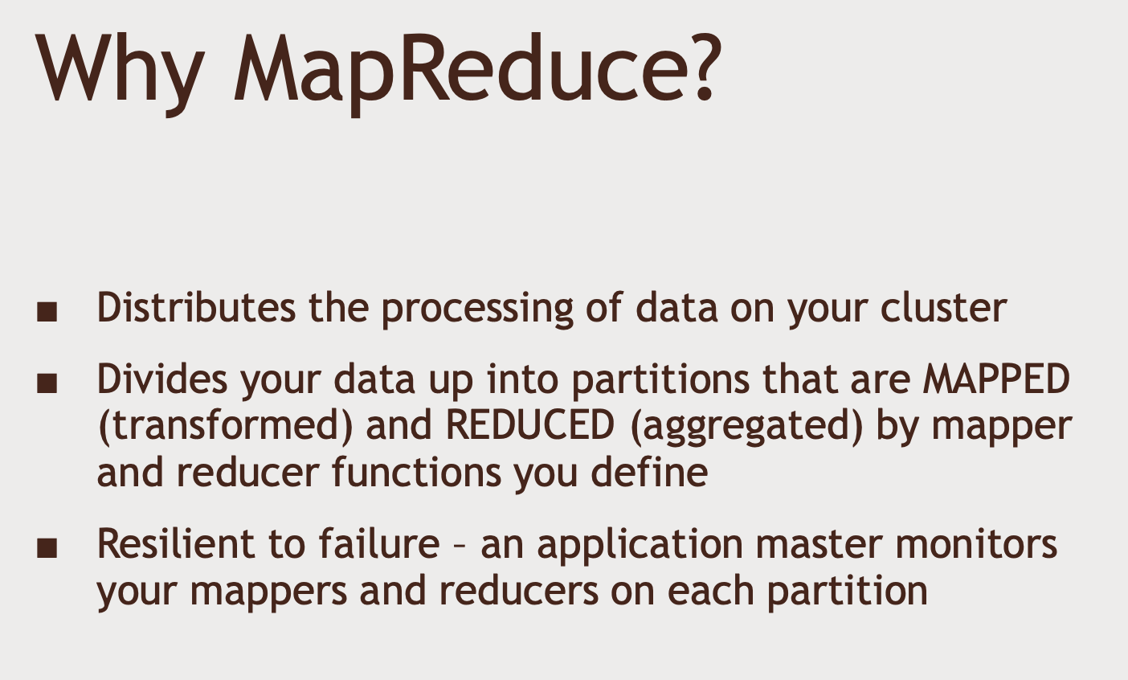
MapReduce: What it is, and how it works

Slide 27
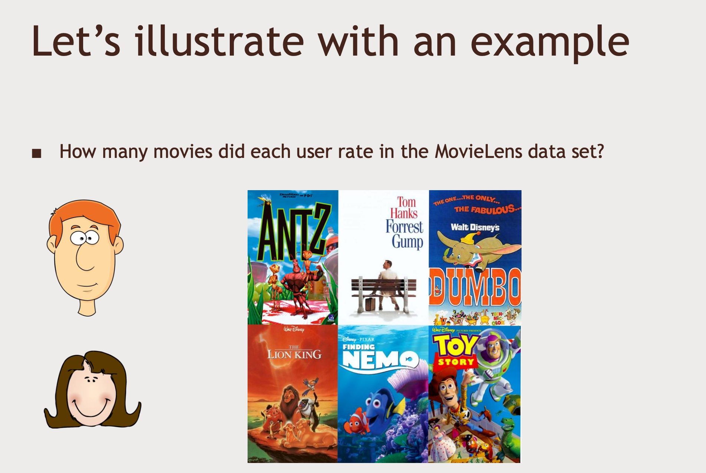

Slide 28
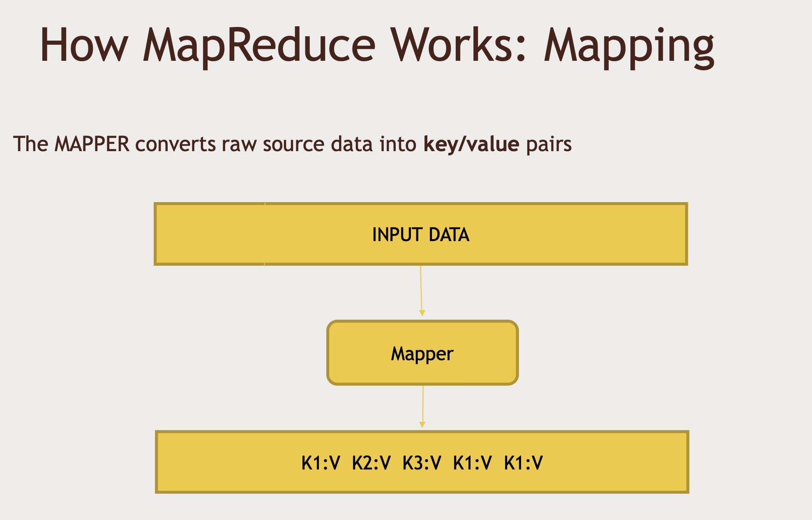

Slide 29
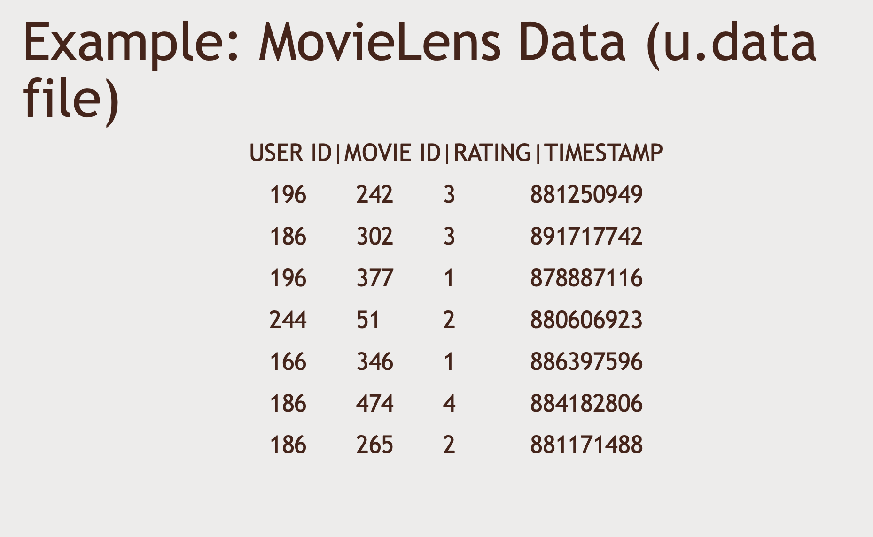

Slide 30
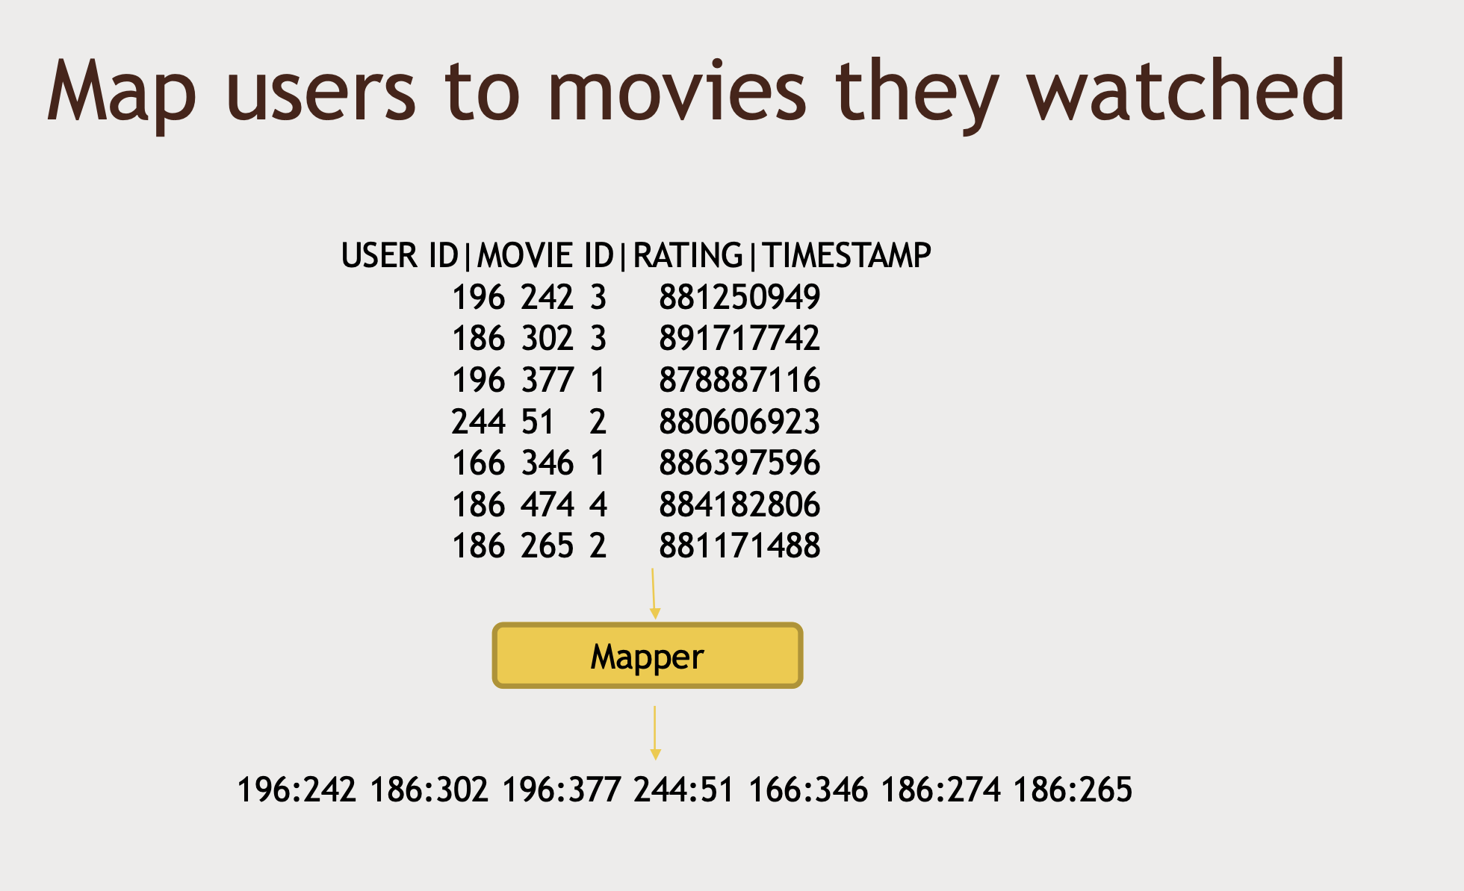

Slide 31
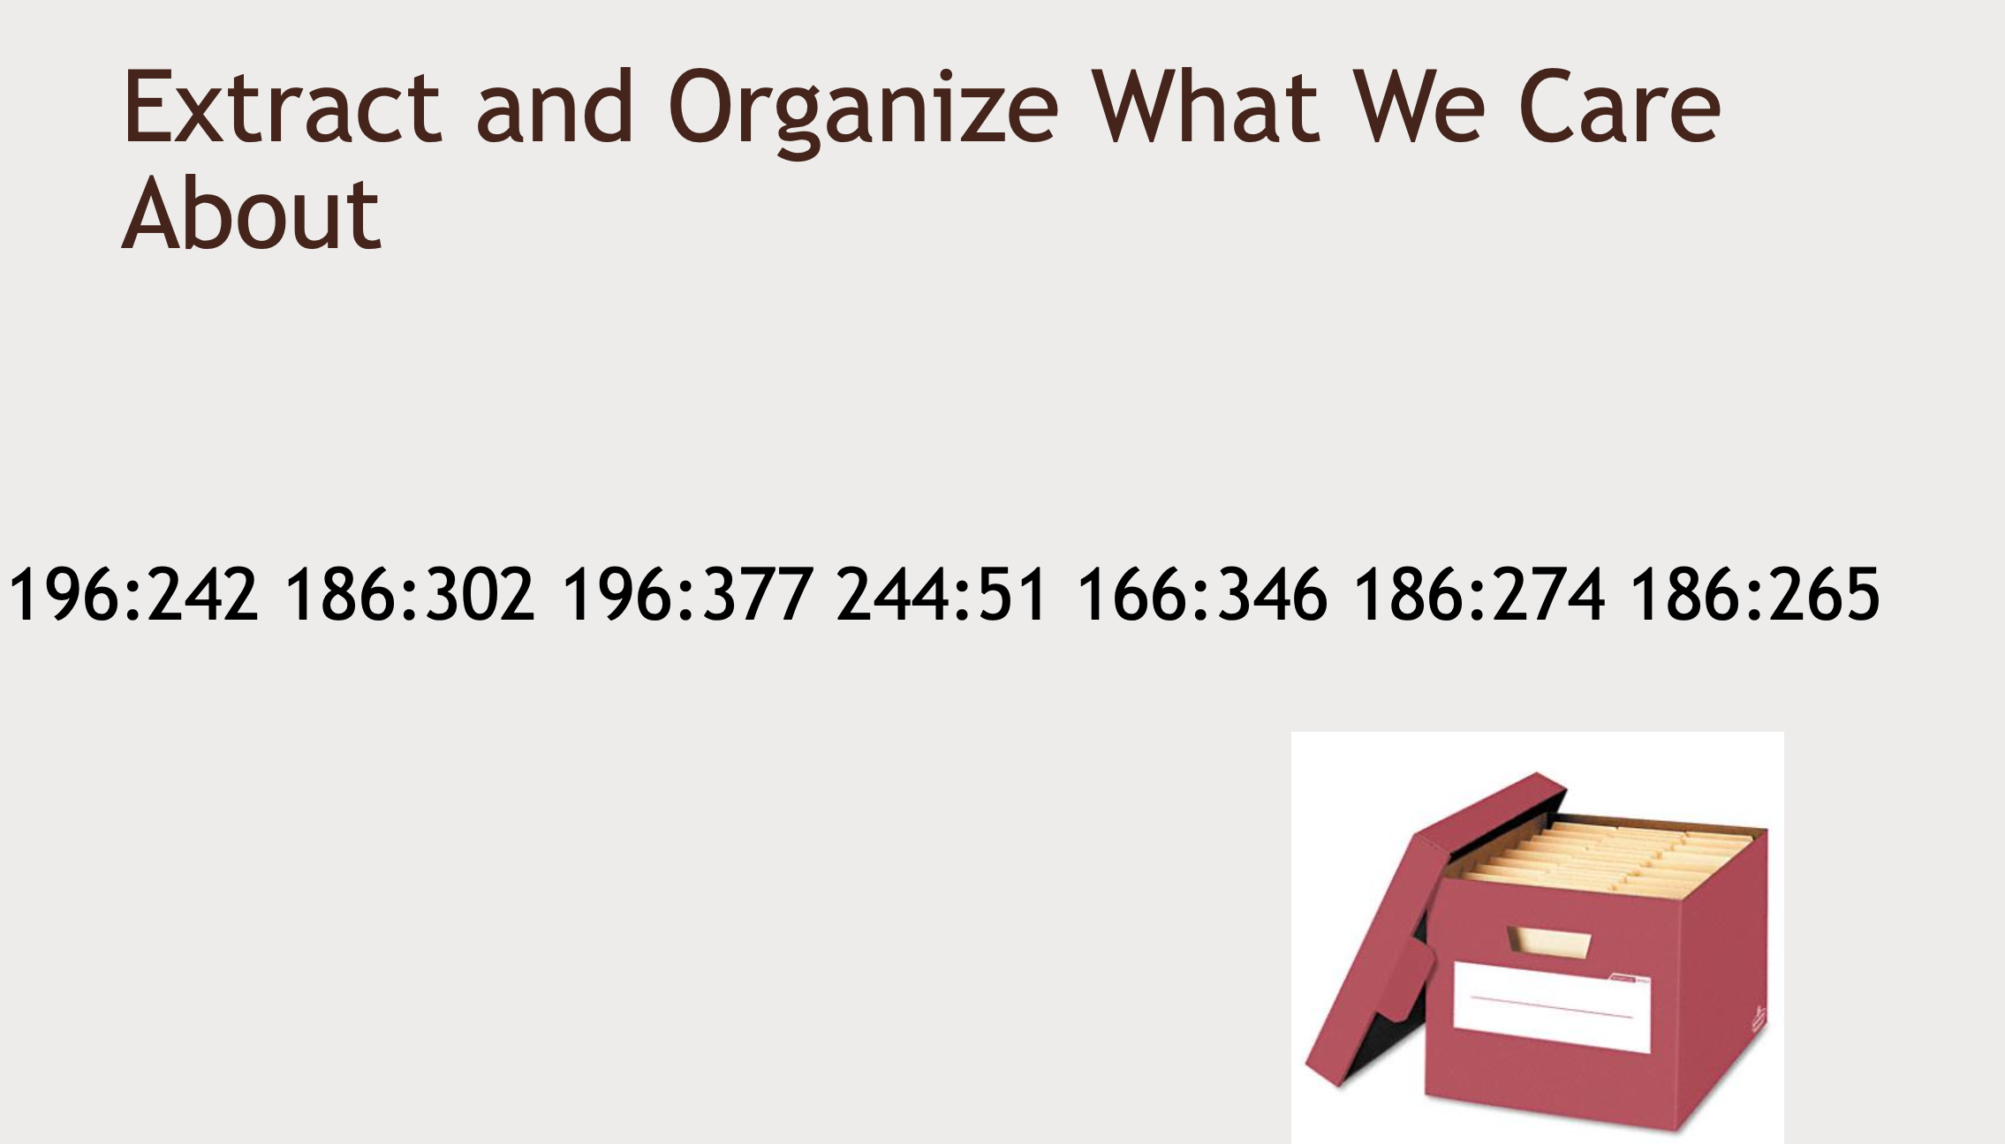

Slide 32
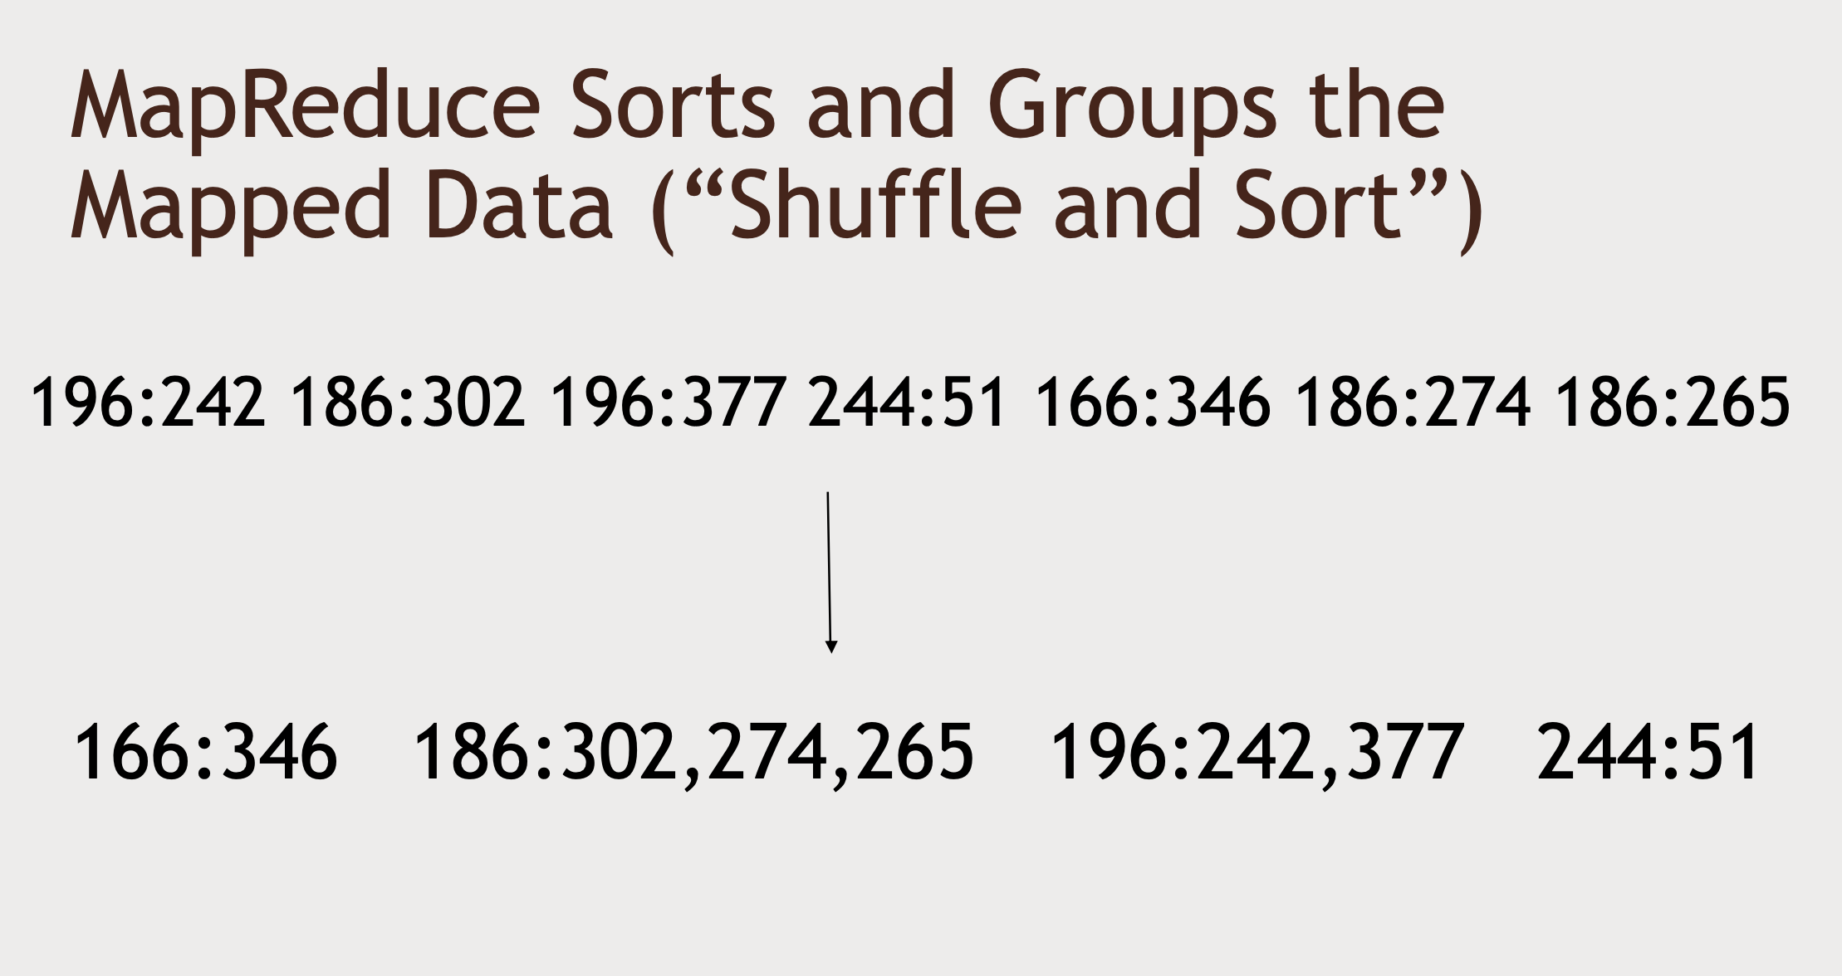

Slide 33
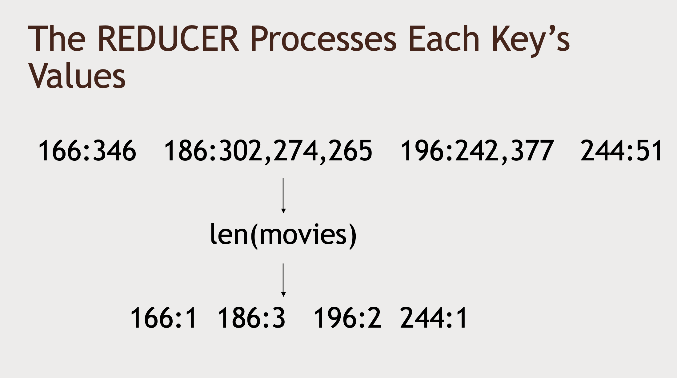

Slide 34
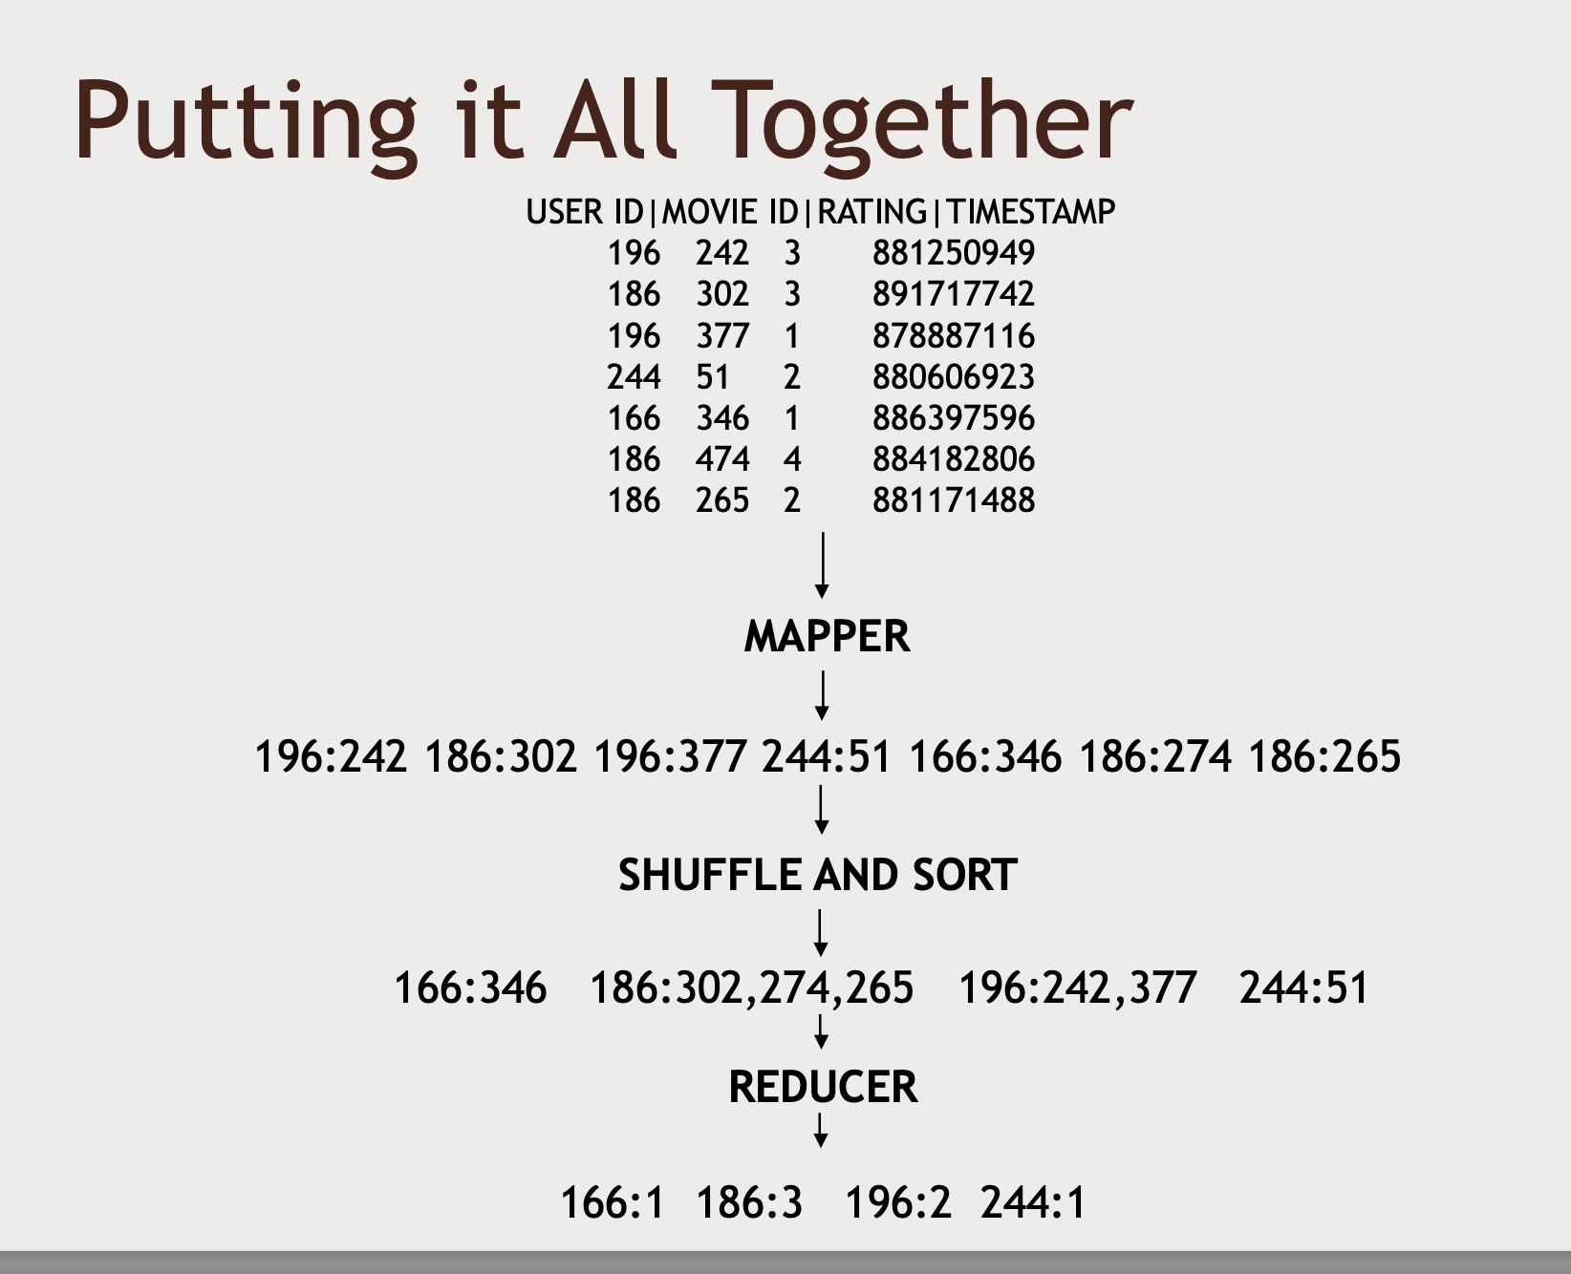

Slide 35

How map reduce distributes processing

Slide 36
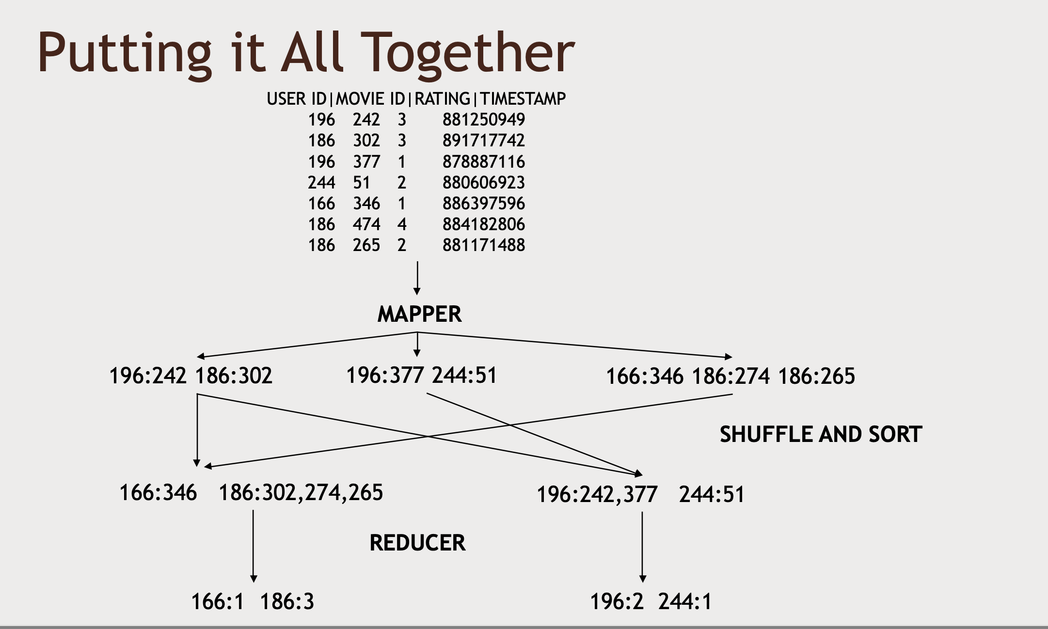

Slide 37
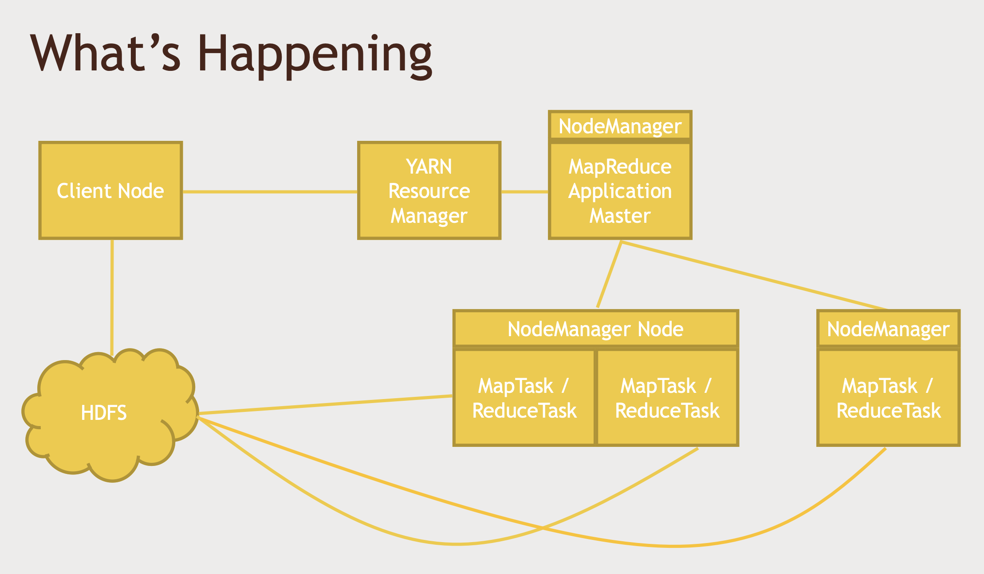

Slide 38
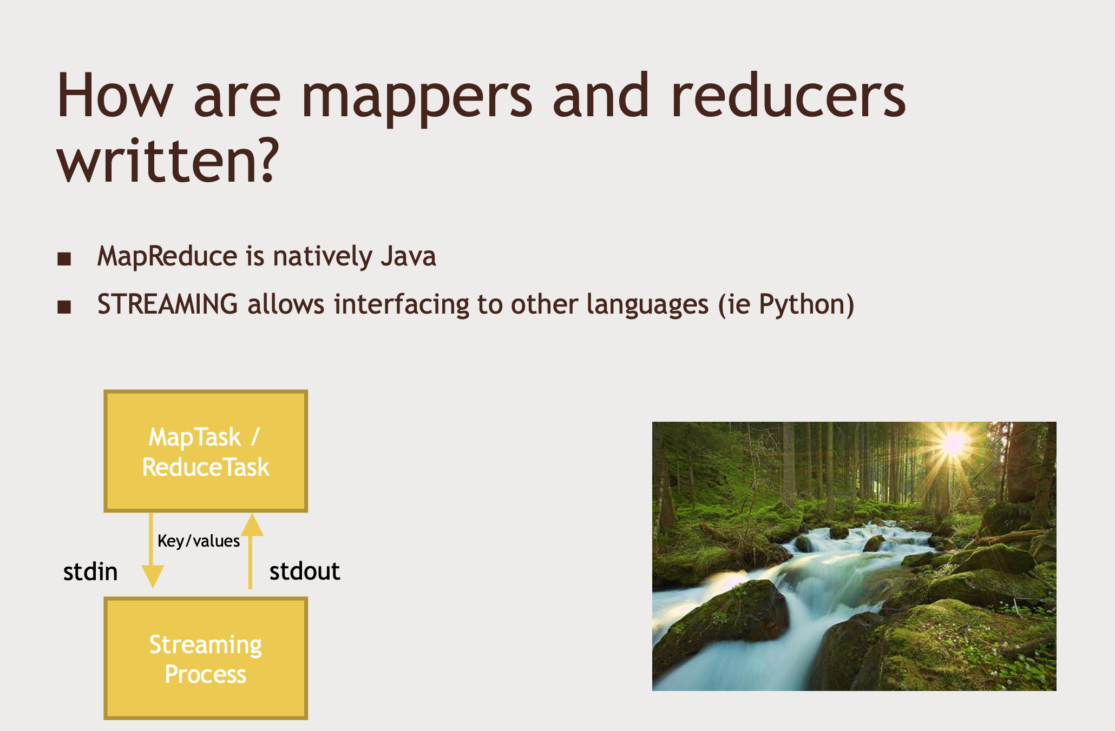

Slide 39
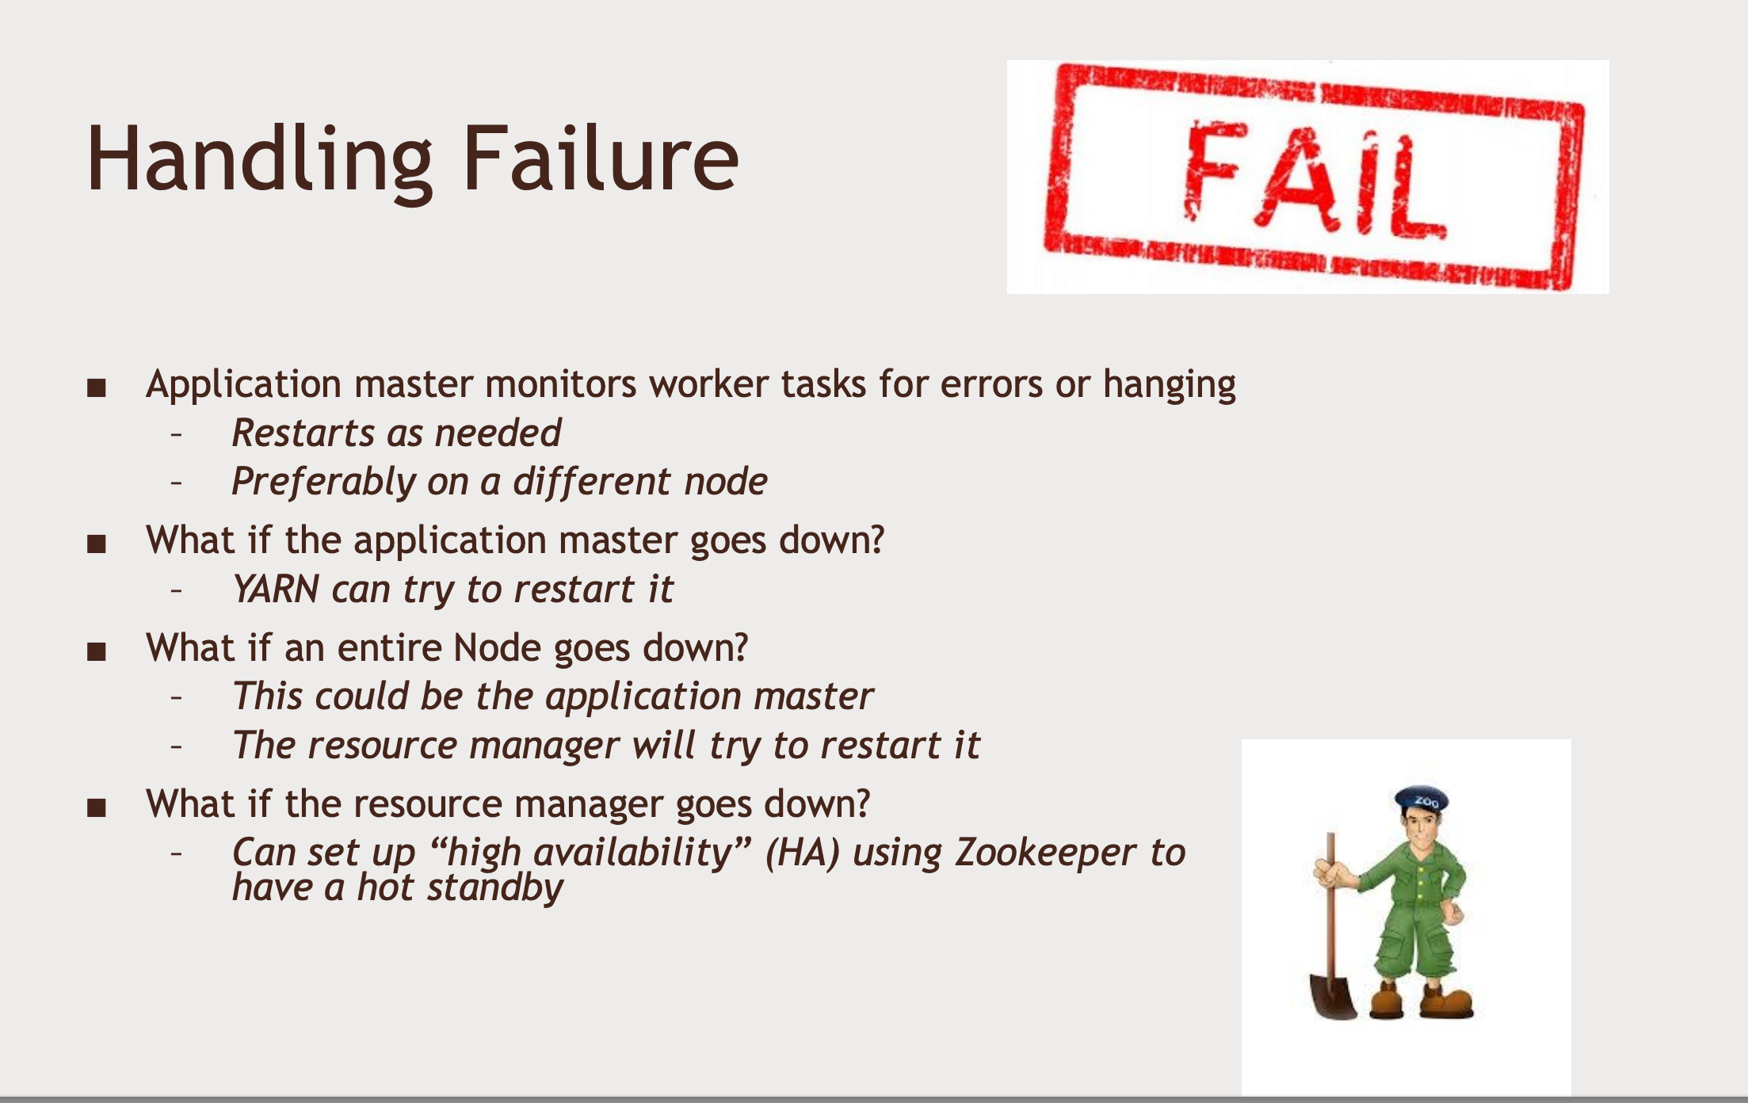

Slide 40

Counters, combiners in MapReduce

Slide 41


Slide 42
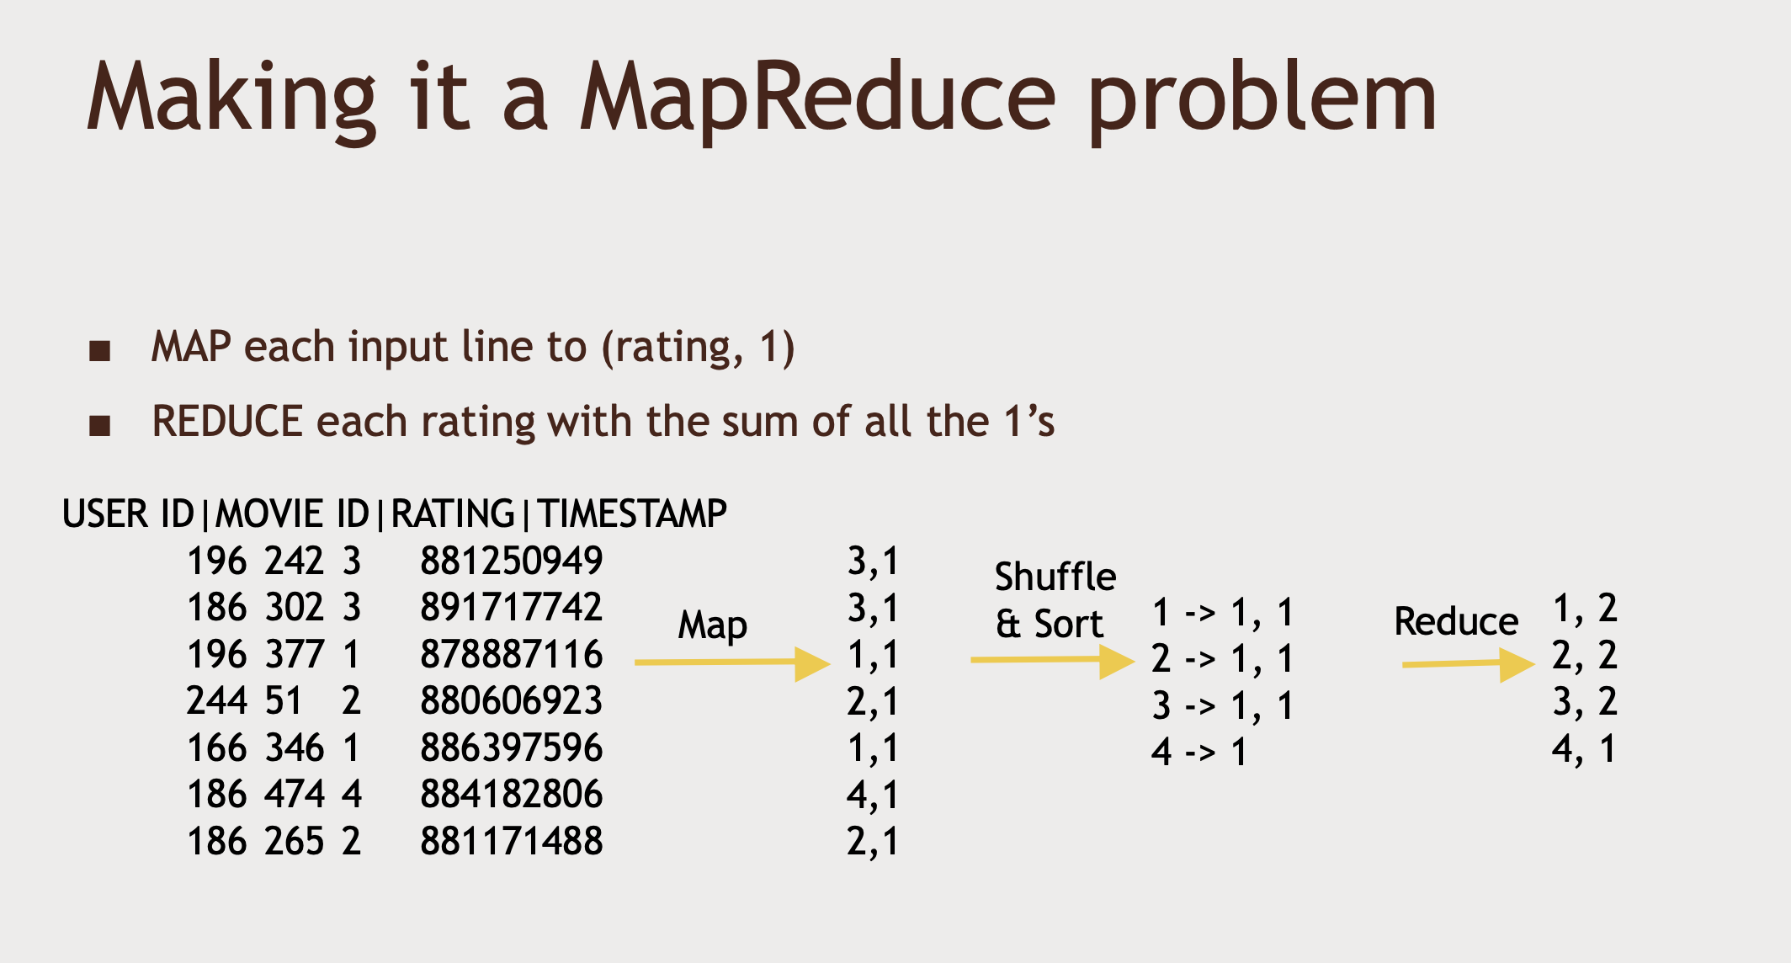

Slide 43
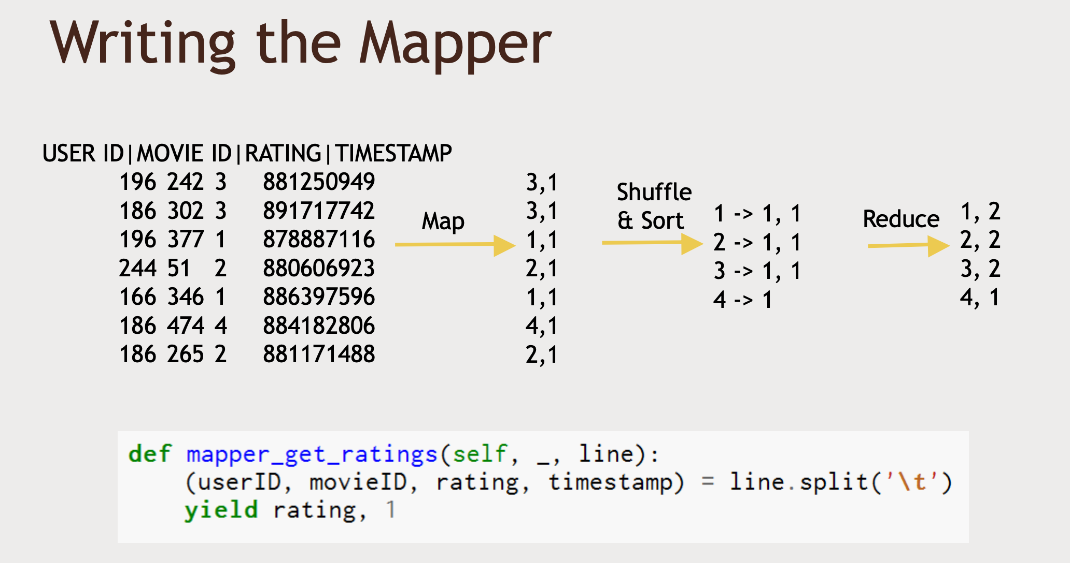

Slide 44
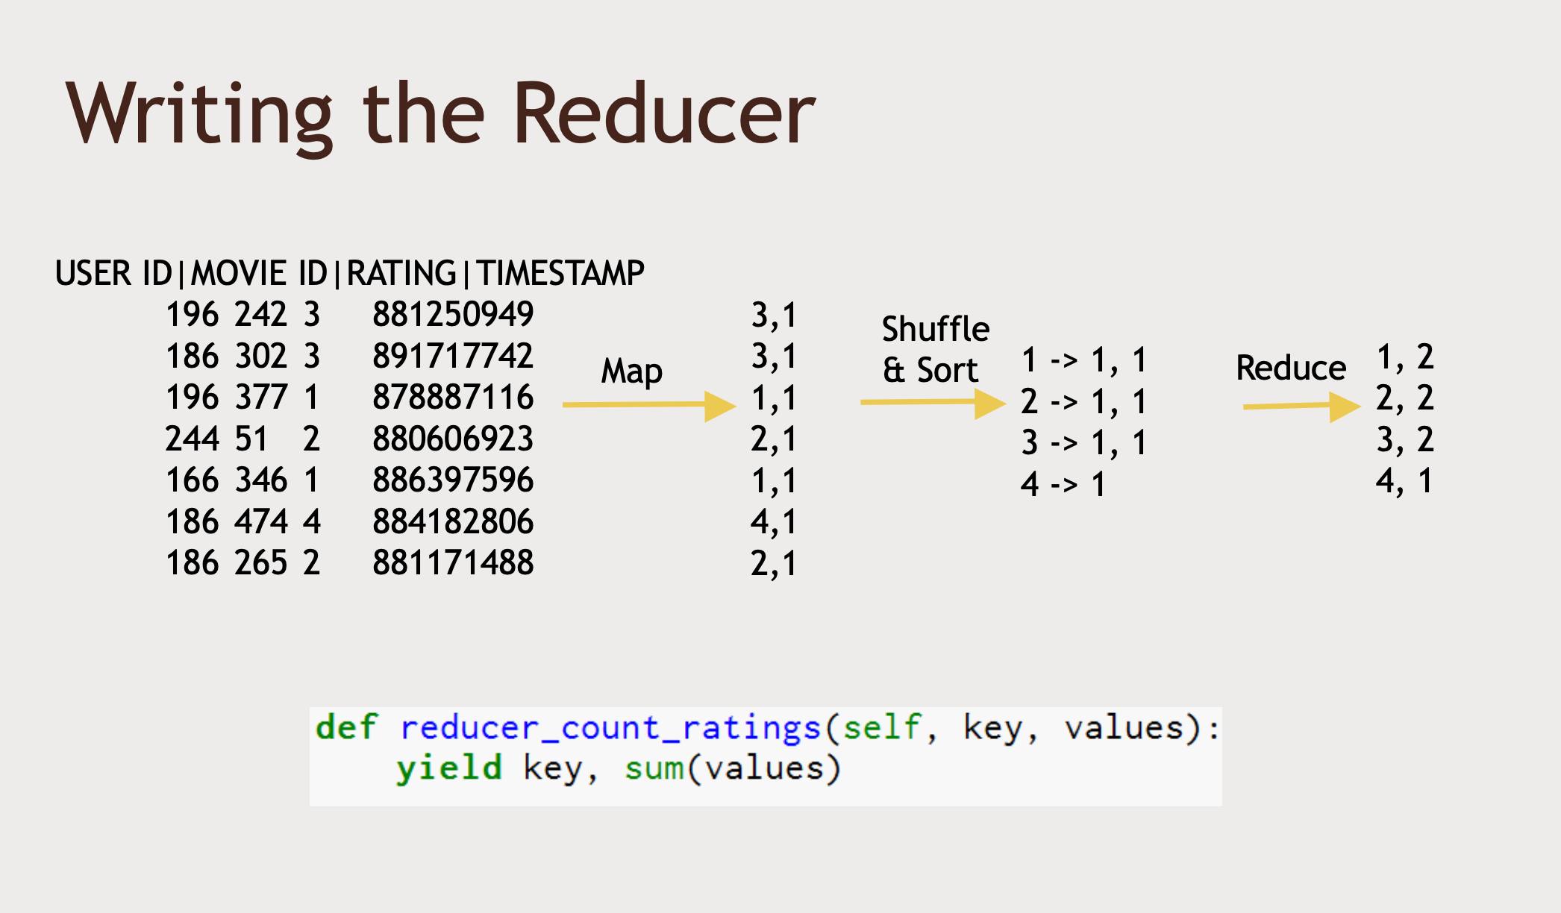

Slide 45
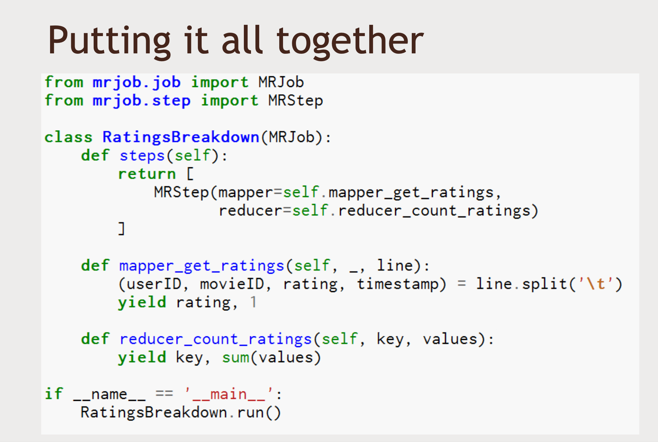

Slide 46
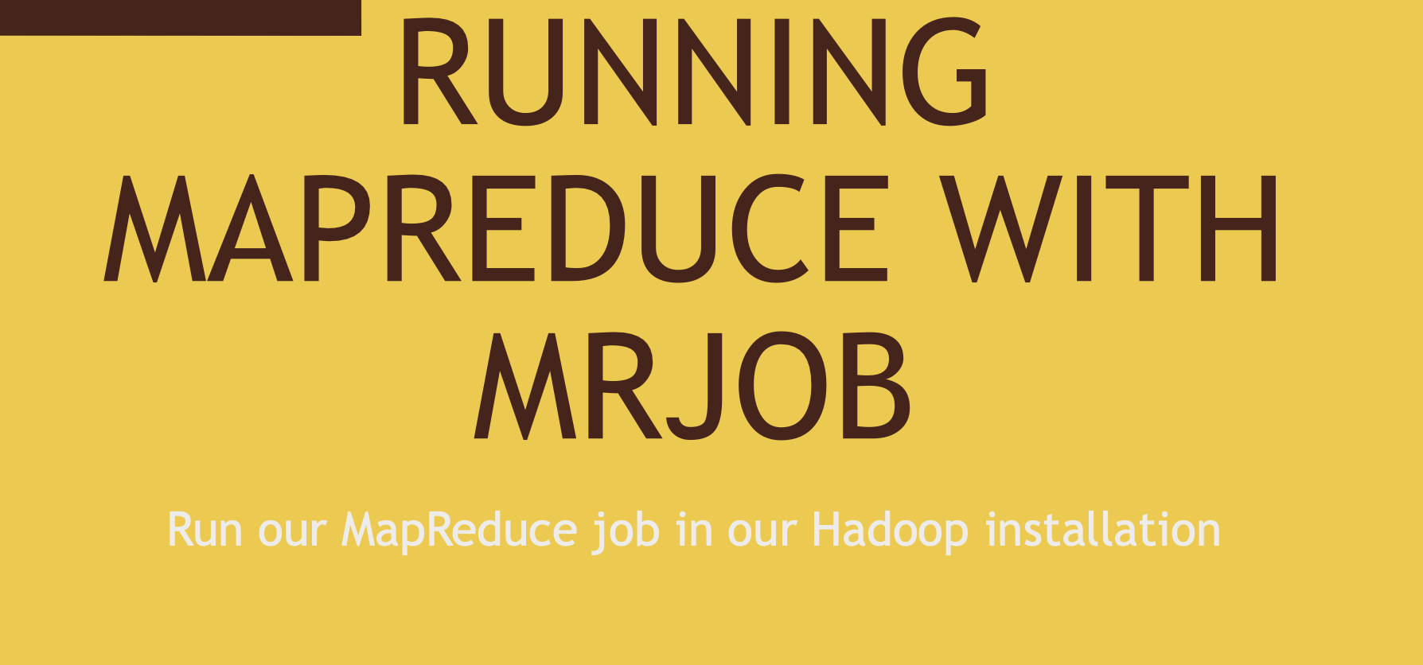

Slide 47
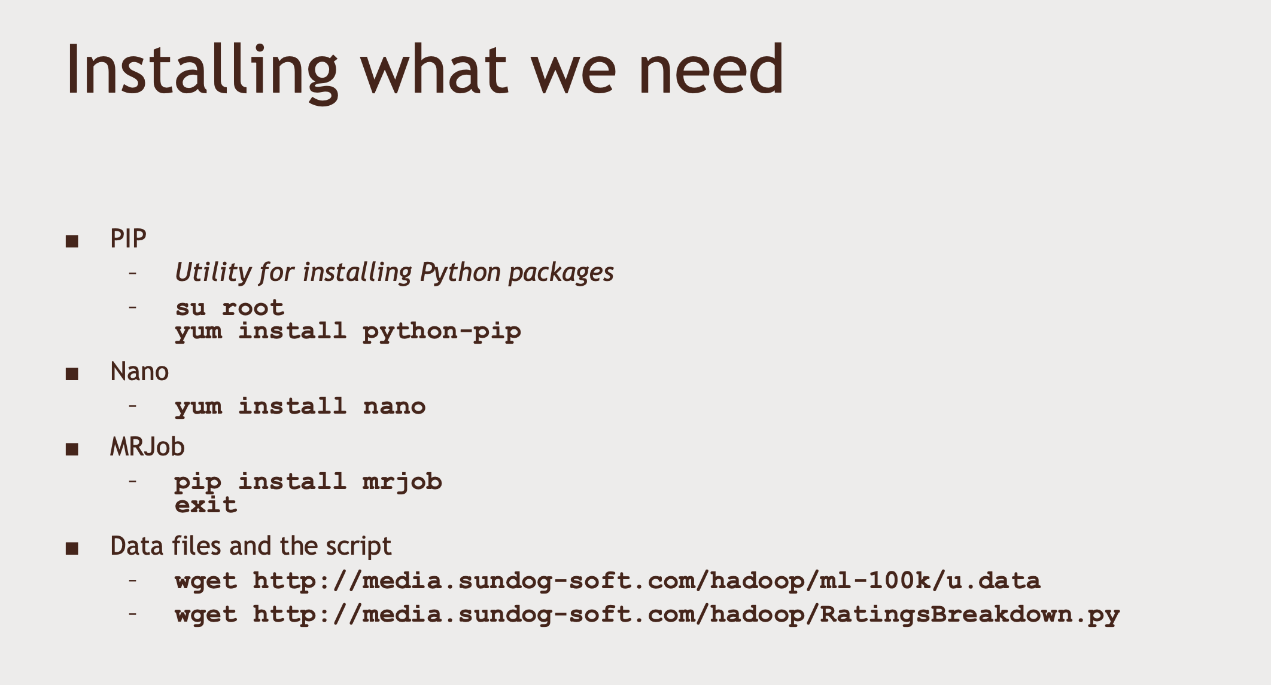

Slide 48
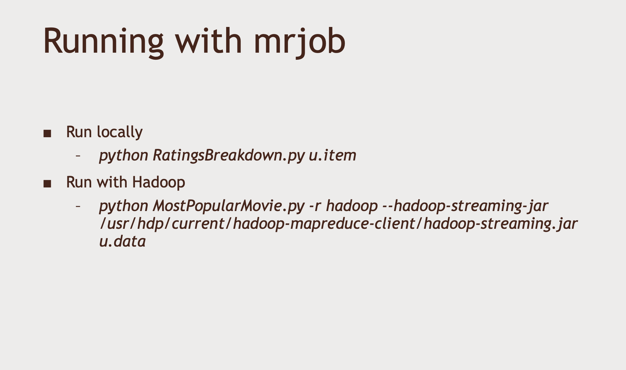

Slide 49
Notes on MRJob installation
In the next activity, we'll walk you through installing the "mrjob" package for MapReduce on the HDP Sandbox.
Installing mrjob on HDP 2.65
The following video will walk you through these steps, but you may find it helpful to have the commands in writing so you can just copy and paste them as you go (be sure to "su root" first, as shown in the video.)

Slide 50
yum-config-manager --save --setopt=HDP-SOLR-2.6-100.skip_if_unavailable=true
yum install https://repo.ius.io/ius-release-el7.rpm https://dl.fedoraproject.org/pub/epel/epel-release-latest-7.noarch.rpm
yum install python-pip
pip install pathlib
pip install mrjob==0.7.4
pip install PyYAML==5.4.1
yum install nano
wget http://media.sundog-soft.com/hadoop/RatingsBreakdown.py
wget http://media.sundog-soft.com/hadoop/ml-100k/u.data

Slide 51
Installing mrjob on HDP 2.5
While going through the next activity, many students are running into an error when entering the command:
pip install google-api-python-client==1.6.4
This seems to arise from a mismatch between python-pip and Python 2.6, but I'm not sure why it only happens for some students and not others. If you do run into this, just update your sandbox to Python 2.7 by entering the following commands:
yum install scl-utils
yum install centos-release-scl
yum install python27
scl enable python27 bash

Slide 52
Now, you should be able to
pip install google-api-python-client==1.6.4
successfully.
If you're still having trouble, please use the Q&A feature for this lecture and we'll help you out.

Slide 53
Su root
Hadoop
For HDP 2.5
Cd /etc/yum.repo.d
Cp sandbox.repo /tmp
Rm –rf sandbox.repo
Cd ~
Yum install python-pip

Slide 54
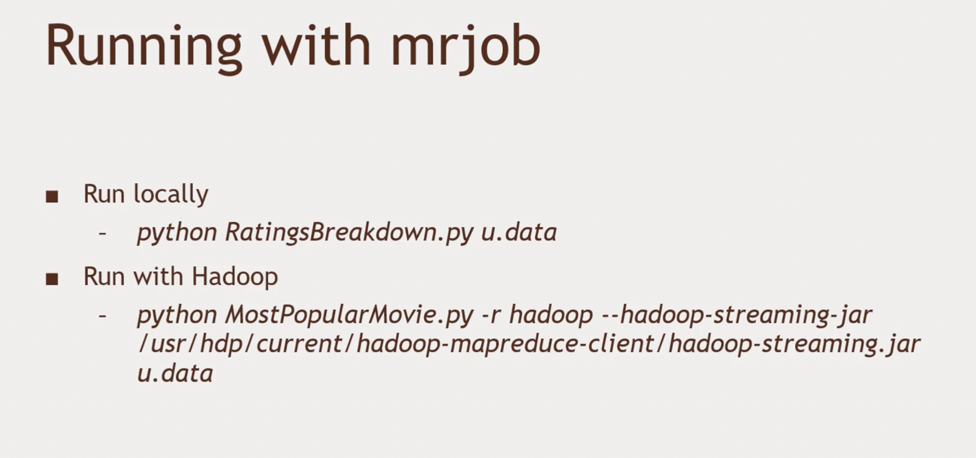
Code up ratings histogram MapReduce Job and run it

Slide 55

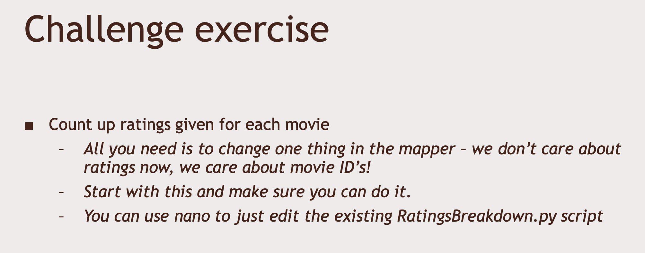

Slide 56
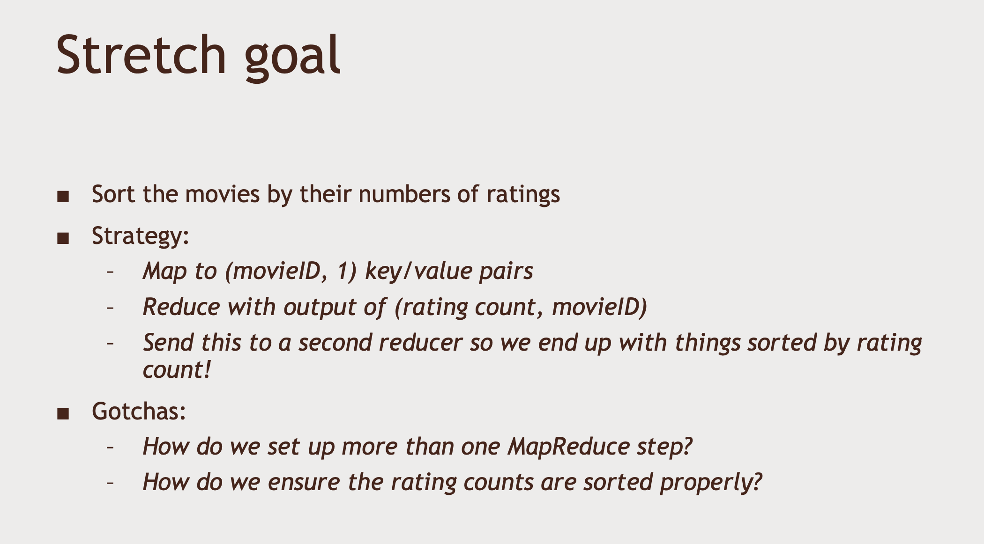

Slide 57
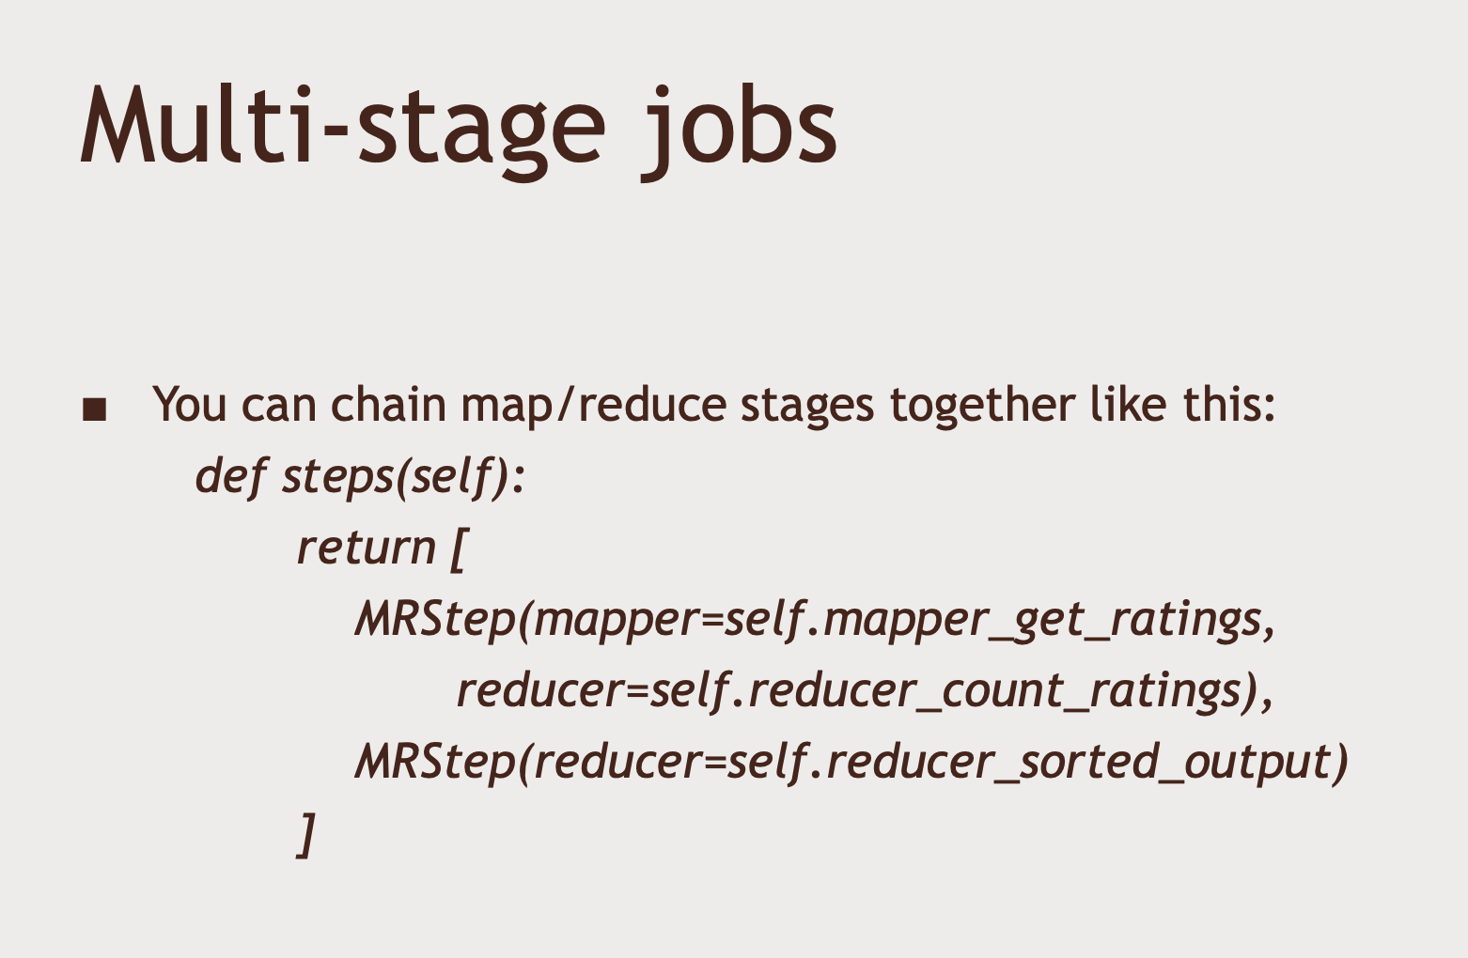

Slide 58
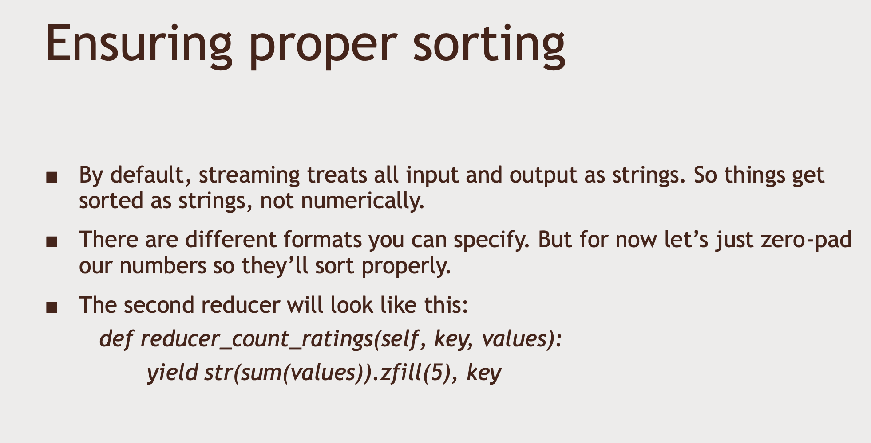

Slide 59
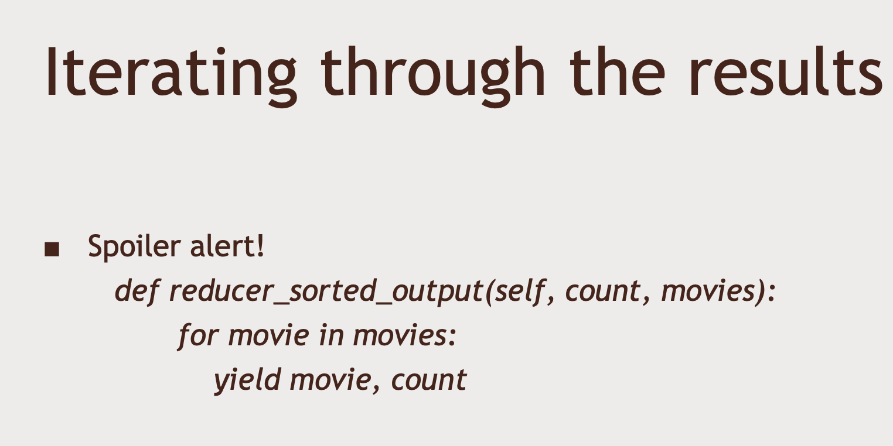


Slide 60
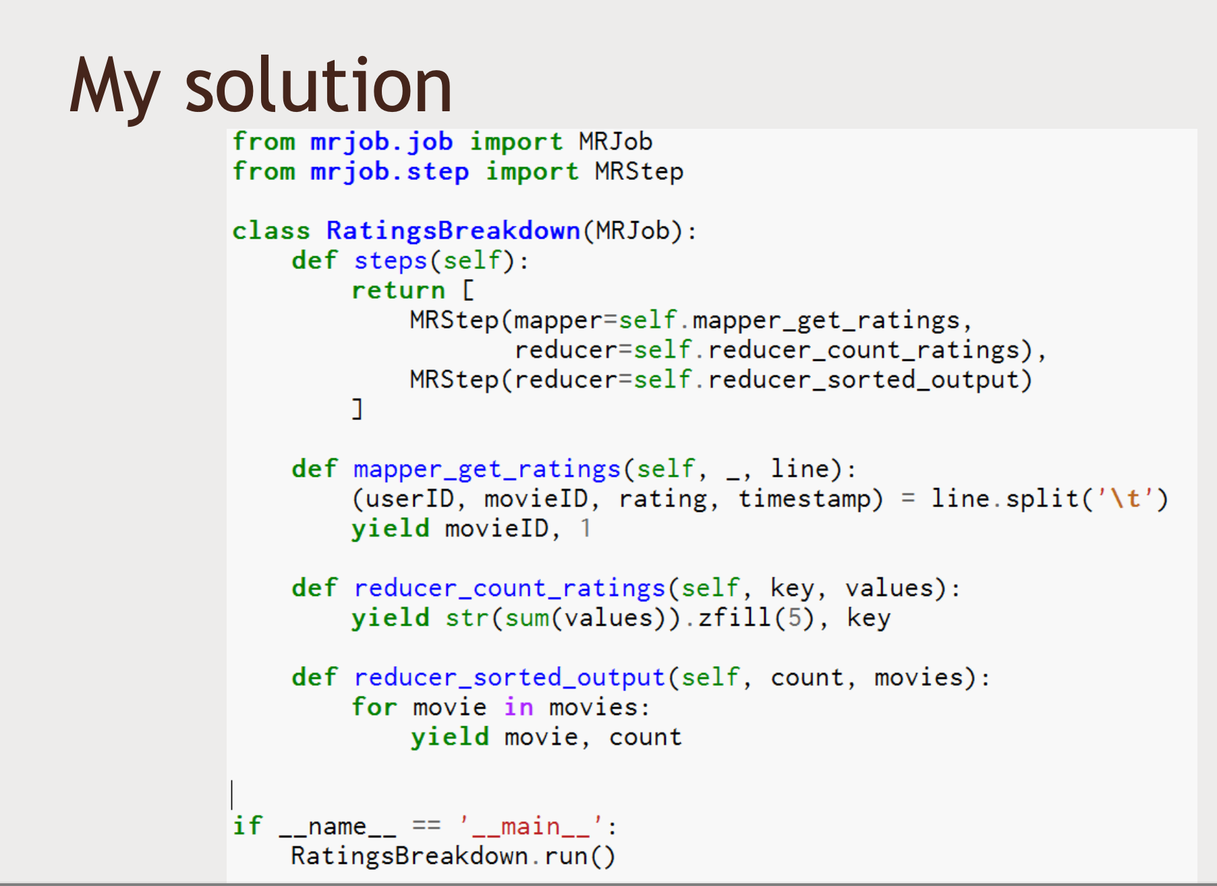

Slide 61
Note: Sorting will only work by partition.
You may notice that your results aren't sorted the same way mine are. Depending on how MapReduce split up the processing of your work, you may be getting results back from each CPU core or from multiple threads reducing the data in parallel. Only data from the same process can be sorted by an individual reducer, so that's expected.
It would be possible to re-sort your final results via some other process once it is all received, but as you'll see in later lectures, more modern technologies such as Spark will handle things like this for you.

Slide 62
Programming Hadoop with PIG

Slide 63
Introducing Ambari
Running Ambari as User
SSH into Hadoop Data Platform
Su root
Ambari-admin-password-reset
YARN Queue Manager
Files View
Hive View
Pig View
Storm view
Tez View

Slide 64
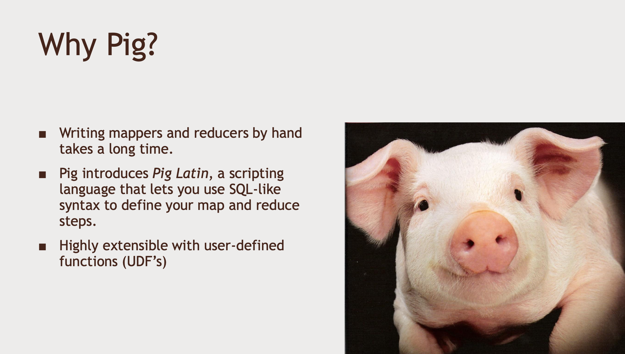
Introducing Pig

Slide 65
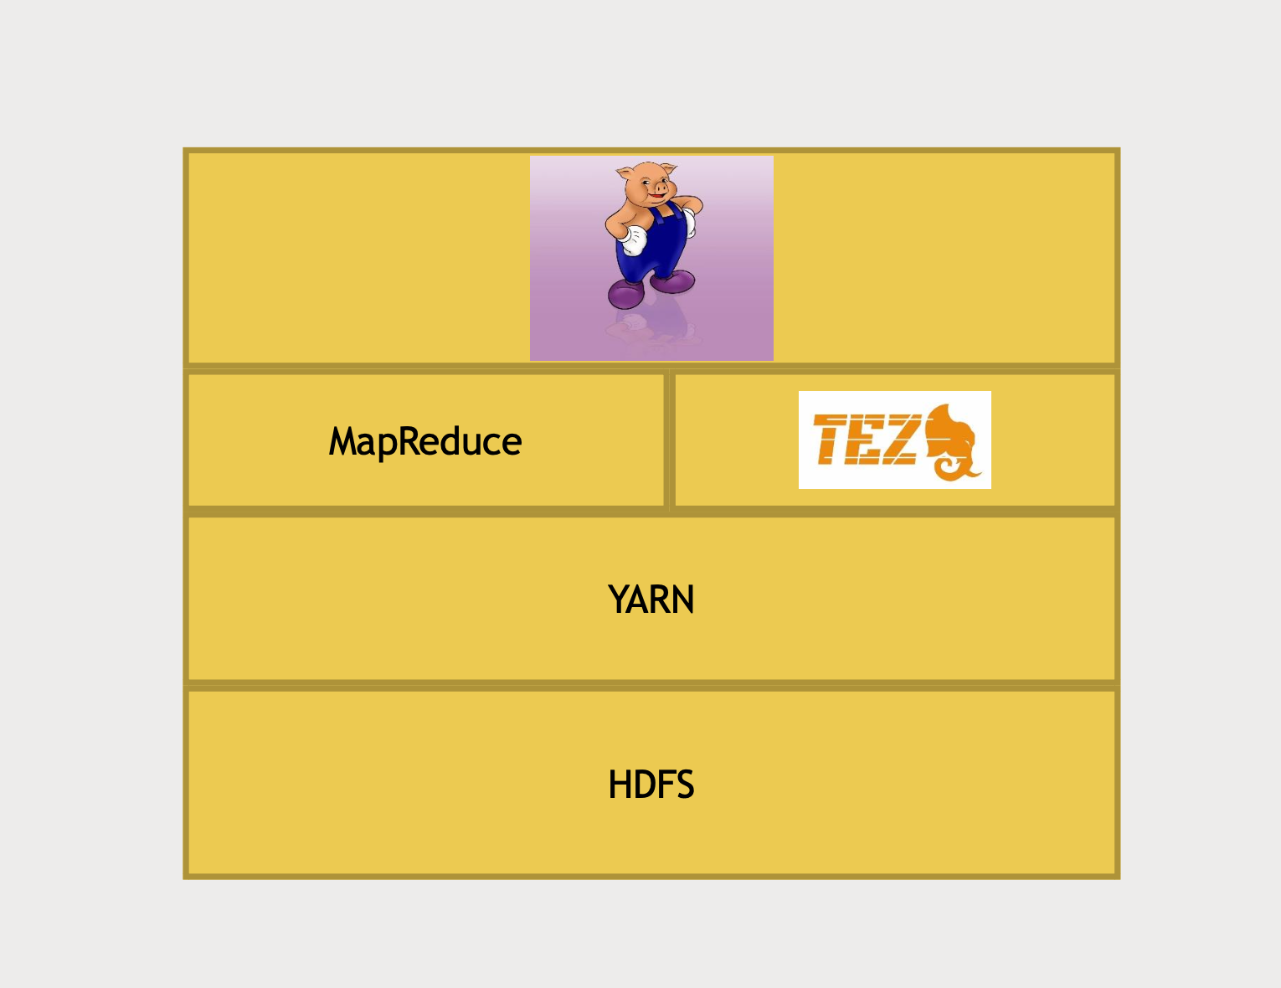

Slide 66


Slide 67

Example: Find the oldest movie with a 5-star ratings using Pig

Slide 68


Slide 69


Slide 70


Slide 71


Slide 72


Slide 73


Slide 74


Slide 75


Slide 76


Slide 77


Slide 78


Slide 79



Slide 80


Slide 81


Slide 82



Slide 83


Slide 84
Programming Hadoop with Spark

Slide 85



Slide 86


Slide 87


Slide 88


Slide 89


Slide 90


Slide 91


Slide 92

The Resilient Distributed Datasets (RDD)

Slide 93



Slide 94


Slide 95


Slide 96


Slide 97


Slide 98



Slide 99
Find the movie with lowest average rating – with RDDs
Got to Ambari Dashboard -> Services -> Spark/Spark 2 -> Configs
Spark-log4j-properties:
ERROR

Slide 100

Datasets and Spark 2.0

Slide 101


Slide 102


Slide 103

Data frames are built on top of RDD, we can extract underlying RDD and perform operations on it

Slide 104


Slide 105


Slide 106


Slide 107

Find the movie with lowest average rating – with Data frame
Movie Recommendation using MLLib
Changes in u.data

Slide 108



Slide 109


Slide 110
Using relational data stores with Hadoop

Slide 111


Slide 112


Slide 113


Slide 114


Slide 115


Slide 116


Slide 117


Use hive to find
Most popular movie

Slide 118


Slide 119


Slide 120


Slide 121



Slide 122


Slide 123


Slide 124


Slide 125


Slide 126


Slide 127


Slide 128


Slide 129


Slide 130


Slide 131
Cheat sheet for the following lecture
In the next lecture, there's a step where you need to set up the default password for MySQL on HDP 2.65, and it involves a lot of typing. We're providing the commands below so you can more easily copy & paste them if you prefer.
Don't just enter this now though, watch the video! There are other steps that must be done first, and you need some context.

Slide 132
su root
systemctl stop mysqld
systemctl set-environment MYSQLD_OPTS="--skip-grant-tables --skip-networking"
systemctl start mysqld
mysql -uroot
------- Mysql cmd
FLUSH PRIVILEGES;
alter user 'root'@'localhost' IDENTIFIED BY 'hadoop';
FLUSH PRIVILEGES;
QUIT;
------ CMD
systemctl unset-environment MYSQLD_OPTS
systemctl restart mysqld

Slide 133
Install MySQL and import our Movie Data
Login using ssh
Mysql –u root –p
Hadoop
Use Sqoop to import data from MySQL to HDFS/Hive
Use Sqoop to export data from Hadoop to MySQL

Slide 134
Hive is Schema on Read, data is stored in file
On Hortonworks
/apps/hive/warhouse/movies/

Slide 135
Using non relational data stores with Hadoop

Slide 136


Slide 137


Slide 138


Slide 139


Slide 140


Slide 141


Slide 142


Slide 143


Slide 144



Slide 145


Slide 146


Slide 147


Slide 148


Slide 149


Slide 150


Slide 151


Slide 152

Import movie ratings into HBase

Slide 153


Slide 154


Slide 155


Slide 156
In Oracle Virtual Box -> right click -> settings -> networking -> advanced -> port forwarding ->
Hbase REST , TCP, 127.0.0.1, 8000 (host Port), 8000 (guest port)
Ambari Dashboard (login as admin) -> Services -> Hbase -> Service actions -> Start
Putty ->
Su root
/usr/hdp/current/hbase-master/bin/hbase-daemon.sh start rest -p 8000 --infoport 8001

Slide 157

Using Hbase with PIG to Import Data at scale

Slide 158


Slide 159


Slide 160

We can use import tsv for also for importing data in Hbase
PIG and Hbase:

Slide 161


Slide 162


Slide 163


Slide 164


Slide 165


Slide 166


Slide 167


Slide 168


Slide 169
If you have trouble installing Cassandra...
In the next lecture, we'll install Cassandra into your sandbox. It's a complicated process, and a lot can go wrong. Really, if you're not pretty comfortable with Linux, you might want to just watch the exercises that involve Cassandra instead of running them yourself.
One common issue is ending up in a state where your RPM database (which keeps track of what packages you have installed on your system) becomes corrupt. You'll experience this as seeing an error message like this:
rpmts_HdrFromFdno – error: rpmdbNextIterator – Header V3 RSA/SHA1 Signature, key ID BAD

Slide 170
If you encounter this, "yum" will no longer work at all. But, there is a way to fix it.
Just enter the following commands (you can paste them into PuTTY by right-clicking in the PuTTY terminal window after copying them; and be sure you've already run "su root" to run the following as the root user:)
cd ~
wget http://mirror.centos.org/centos/6/os/x86_64/Packages/nss-softokn-freebl-3.14.3-23.3.el6_8.x86_64.rpm
rpm2cpio http://mirror.centos.org/centos/6/os/x86_64/Packages/nss-softokn-freebl-3.14.3-23.3.el6_8.x86_64.rpm | cpio -idmv
cp ./lib64/libfreeblpriv3.* /lib64

Slide 171
Now, yum should work again. Note that if you do a big "yum update" and the ssl library is updated, you may lose your connection via PuTTY. If you're disconnected, wait a couple of minutes to allow yum to finish what it's doing, issue an ACPI Shutdown command to the virtual machine (via the Machine menu,) restart the sandbox, and connect again.
And if *that* didn't work, you can try following the similar instructions at https://techjourney.net/centos-yum-rpm-error-rpmts_hdrfromfdno-rpmdbnextiterator-header-v3-rsasha1-signature-key-id-bad/ instead (follow the steps for x64 CentOS.)

Slide 172

[Activity] Installing Cassandra

Slide 173

[Activity] Write Spark Output into Cassandra

Slide 174


Slide 175


Slide 176


Slide 177


Slide 178


Slide 179


Slide 180


Slide 181


Slide 182


Slide 183


Slide 184


Slide 185


Slide 186
[Activity] Install MongoDB, and integrate Spark with MongoDB
[Activity] Using the mongodb shell
If “mongo” gives you an error, try entering
export LC_ALL= C
First.

Slide 187


Slide 188


Slide 189


Slide 190


Slide 191


Slide 192


Slide 193


Slide 194



Slide 195



Slide 196



Slide 197


Slide 198

[Exercise] Choose a Database for a given problem
Mongo DB

Slide 199
Querying your data interactively

Slide 200


Presto can talk with Cassandra and not mongodb,
Drill can talk with mongodb and not cassandra

Slide 201


Slide 202


Slide 203



Slide 204


Slide 205


Slide 206
[Activity] Setting up Drill
[Activity] Querying across multiple databases with Drill

Slide 207


Slide 208


Slide 209


Slide 210


Slide 211


Slide 212


Slide 213


Slide 214
[Activity] Install Phoenix and query Hbase with it
[Activity] Integrate Phoenix with PIG

Slide 215


Slide 216


Slide 217


Slide 218


Slide 219


Slide 220
[Activity] Install Presto and query Hive with it
[Activity] Query both Cassandra and Hive using Presto

Slide 221
Managing your cluster

Slide 222


Slide 223


Slide 224


Slide 225


Slide 226


Slide 227


Slide 228


Slide 229


Slide 230


Slide 231


Slide 232


Slide 233

https://tez.apache.org/

Slide 234


Slide 235


Slide 236


Slide 237

[Activity] Use Hive on Tez and measure the performance benefits

Slide 238


Slide 239


Slide 240


Slide 241


Slide 242


Slide 243


